Slide 1

1. Why soil behaves as it does
Mike Jefferies, PEng
Dr. Dawn Shuttle, PEng
January, 2015

Slide 2
Preamble
Soil behaves according to effective stress
Drained loadings are vastly quicker with sands
    Explore the nature of soil behaviour primarily using sands
Effect of void ratio initially done using clays as easy to measure void ratio using water content
Modern understanding blends understanding from sands and clays together
    Grain size does not matter
    Everything is particulate
    Accurate ‘as-tested’ void ratio in sands now achievable

Slide 3
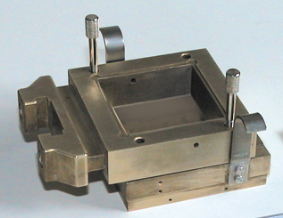
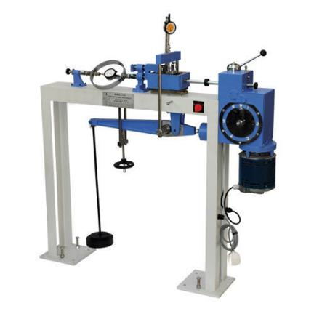
Testing of soils 100 years ago
τ_{vh}
σ_{v}
Controlling drainage…
  Difficult to encase sample in membrane
  => difficult to measure pore pressure
Only measure half the stresses…
  In plane-strain 4 stresses: σ_{v}, σ_{h}, τ_{vh}, σ₂

Slide 4
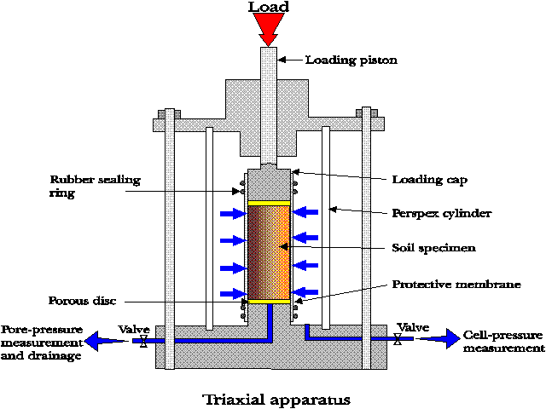
Triaxial compression test: ~1940 onwards
Measure
  Axial load
  Axial deformation
  Radial stress σ_{r}′
  Pore pressure
  Volume change
Compute
  σ_{a}′
  ε_{a}
  ε_{v}

Slide 5
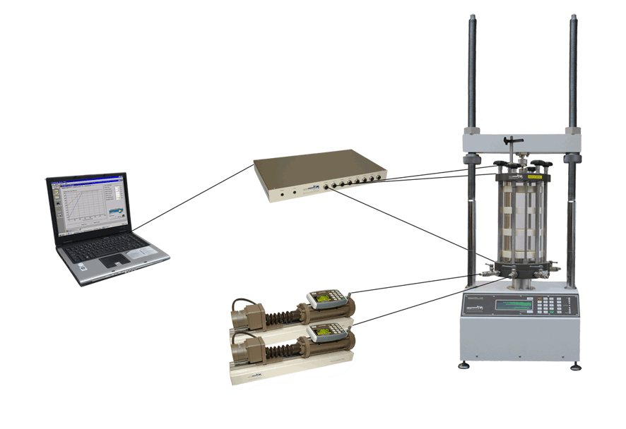
Modern simple triaxial equipment
50 kN USB load frame for specimen shearing
GDSLab software for hardware control & data acquisition
Serial pad for data acquisition
Triaxial cell with internal load cell, pore pressure and axial displacement transducers
USB digital pressure controllers for application of confining and back pressures
Notes:
Primary components of a TAS.

Slide 6
Advantages and disadvantages of triaxial
Everything is measured
Symmetry and fixed loading-deformation directions
  Gives simplicity, but cannot explore all behaviour
  Not plane-strain
Samples do not deform uniformly
  Need ‘area’ corrections to convert load to stress
  Can do ‘local strain’ measurements
3000 pts to 15% ε_{a}

Slide 7
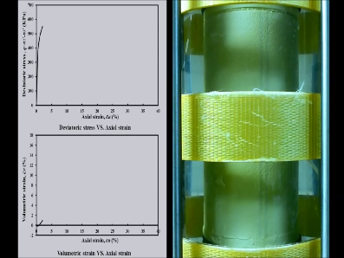
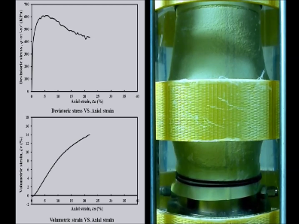
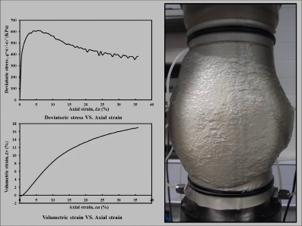
Triaxial is not ‘perfect’ σ−ε data…
σ_{axial} = F / A
Notes:
Visually shows a CD (consolidated drained) triaxial test taking place. Intends to give potential users a feel of what real triaxial test data looks like, along with real specimen deformation.

Slide 8
Deformation components
=
+
Deformation = volume change + pure distortion
Volumetric strain: ε_{v} Deviatoric strain: ε_{q} = ε₁- ε_{v}/3
Mean stress: Deviator stress:
p = (σ_{a}+ 2σ_{r})/3 q = (σ_{a}- σ_{r})

Slide 9
Drained triaxial test
Controlled by
your choice

Slide 10
Undrained triaxial tests
u_{e}
u
‘stress-path’
Your choice by closing drainage valve

Slide 11
PRINCIPLE
Soil properties cannot be changed by closing a valve !
Everything fits within an
effective stress framework

Slide 12
Shear box data (Skepton & Bishop, 1950)
Terzaghi model of soil strength

Slide 13
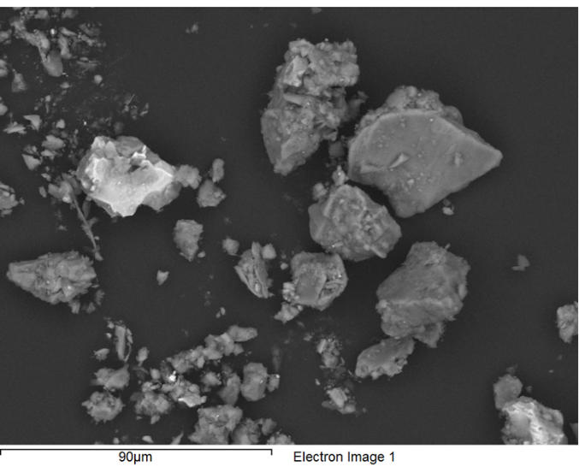
Example of particle shapes

Slide 14
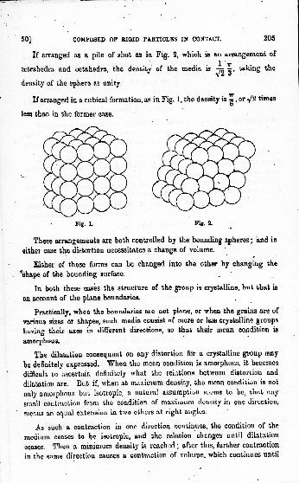
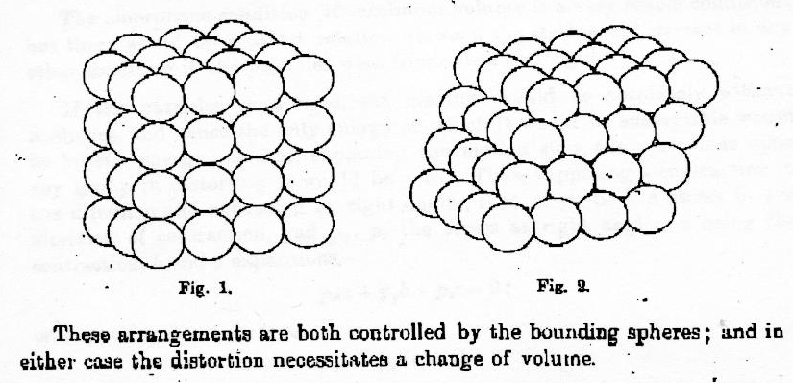
1885: Distortion causes dilation
Reynolds, 1885

Slide 15
Taylor – Bishop (1950)
Work being done
against confining stress

Slide 16
Soil strength as two components
“Strength” = “Friction” + “Interlocking”
Friction
[Taylor-Bishop, 1948-50]

Slide 17
Understanding Terzaghi’s error
Taylor’s history in ‘light reading’
Terzaghi model of soil strength
δ =
10º
20º
15º

Slide 18
Switch from shear-box to triaxial
η = q / p is used instead of… τ/σ_{n}
D = δε_{v} / δε_{q} is used instead of… δv/δΔ
“eta”
“dilatancy”

Slide 19
Taylor-Bishop strength model in practice
SAND
η_{max} = Μ_{tc} – (1-N) D_{min}

Slide 20
Taylor-Bishop strength model in practice
CLAY
η_{max} = Μ_{tc} – (1-N) D_{min}

Slide 21
What happens before peak strength ?
η = f(D)

Slide 22
What happens before peak strength ?

Slide 23
Mobilized friction ratio
Μ_{i} = η + D

Slide 24
Stress-dilatancy at all strains ~1965
η = M – f(D)

Slide 25

Franklin Falls (NH) 1935
‘sand flow failure'

Slide 26
Critical state undrained

Slide 27
1939: Fort Peck Dam

Slide 28
Critical state locus: CLAYS ~1955

Slide 29
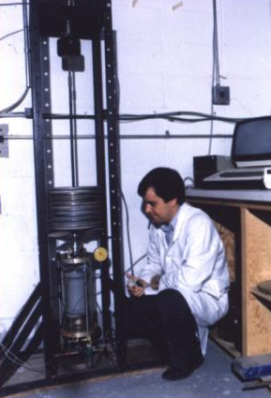
Castro: SANDS - Load controlled tests (1969)

Slide 30
Critical State Locus: SANDS and SILTS ~ 1990
Δe < ± 0.02
λ₁₀

Slide 31
Void ratio measurement
Large and
non-systematic
void ratio changes
during saturation

Slide 32
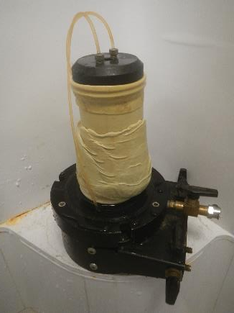
Measuring void ratio accurately: e = G_{s} w
Sladen & Hanford
Sladen & Handford (1987)

Slide 33
Cross-lab trial (freezing method)
Seven laboratories
BGC
Golder-Perth
Golder-YVR
KCB
TriLabs
U Porto
UWA
Δe_{c} = ± 0.02

Slide 34
THE QUESTION:
In the Taylor-Bishop strength concept...
Why does a particular value
of D_{min} develop ?
η_{max} = Μ_{tc} – (1-N) D_{min}

Slide 35
Franklin Falls (NH) 1935
Large Displacement

Slide 36
Casagrande’s results as math
Casagrande…
ψ ➔0 as ε_{γ}➔∞
e
ψ
ln(p)
First-order rate equation
Notes:
Substitute for pc in 1-eta/M = ln(p/pc)

Slide 37
Limiting dilatancy: A little math (sorry)..
Axiom 2: ψ ➔0 as ε_{q} ➔∞
dψ = - Χ ψ dε_{q}
D_{min}= Χ ψ
Concurrent, not initial, value
Derivation is Appendix A of Course Notes

Slide 38
And the measured behaviour is: D_{min} = Χ ψ
Χ
D_{min}

Slide 39
More soils: D_{min} = Χ ψ
Χ

Slide 40
Strength: η_{max} = Μ − (1−Ν) Χ ψ
Effect of fines: D_{r} does not work
Initial

Slide 41
How state parameter operates
SAME SOIL PROPERTIES
Soil state controls how much dilatancy can develop
Stress-dilatancy controlled by dissipation of plastic work

Slide 42
SUMMARY
Soil behaviour is particulate and captured using a few soil properties
    Stress-dilatancy: Μ, Ν
    Critical state: Γ, λ₁₀
    State-dilatancy: Χ
No constitutive model as such involved
Properties do not belong to anybody: just plot data the right way
Developed over about 100 years
Triaxial compression is the reference test to determine soil properties
  Need both drained and undrained
  Need both loose and dense tests

Slide 43
TUTORIAL 1: Determine properties of a sand
Go to folder Templates for Exercises in the downloaded files
  Beaufort Sea construction sand
  Laboratory testing report as pdf file (note this covers several soils)
  Triaxial data imported to NorTxl2(r11)_Nerlerk_270_(blank).xls
  ‘Enable Macros’ when opening !
YOU …
  Determine: Γ, λ₁₀, Μ, Ν, Χ
      Table with values and possible precision
  Provide plots substantiating your assessment
      Paste into Word as ‘enhanced metafiles’ from xls

Slide 44
Plots needed (soil property plots)

Slide 45
Nerlerk Data “Summary & Properties”
1: Summarizes best fits to data
2: Automates calcs in the xls
=‘Test3’!F18

Slide 46
Step 1: Estimate CSL
Each triaxial test is on its own tabbed sheet
  Review data and assess key values
  Key values transferred to ‘summary’ worksheet
  Work through all undrained tests first
  No loose drained tests in this data
Properties by computing and plotting trend lines
  Adjust Γ, λ₁₀ to get nice fit through critical state
  Investigate the limits of combinations that are plausible

Slide 47
Nerlerk Data “Soil Property Plots”

Slide 48
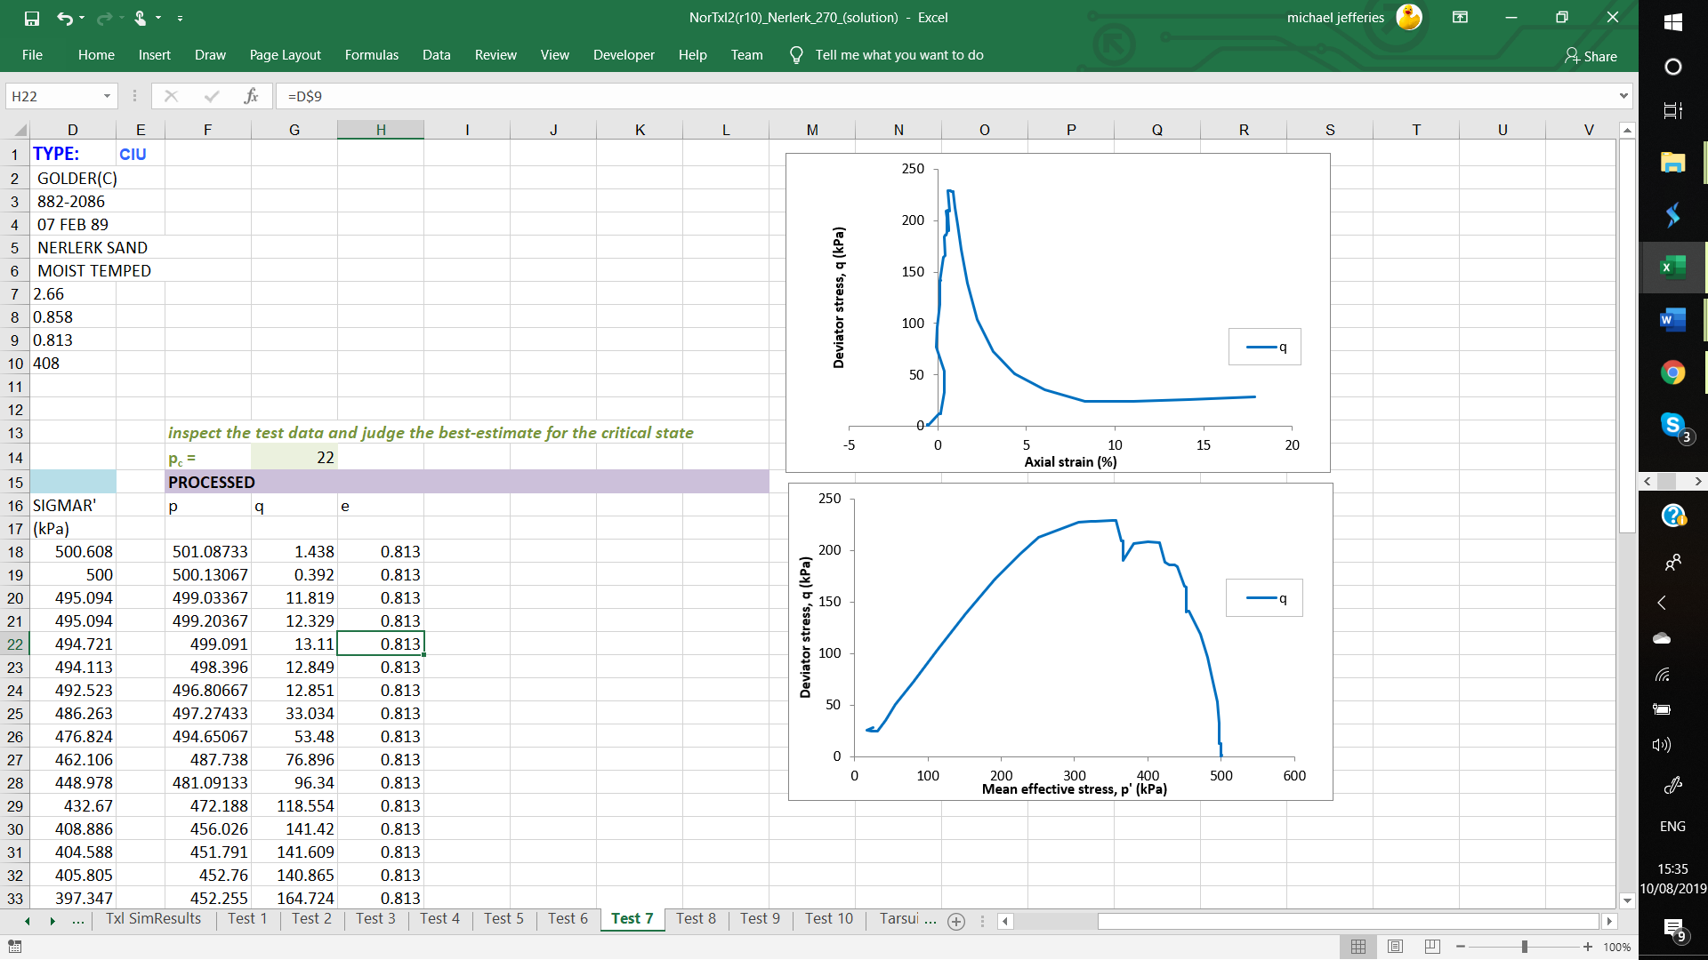
Show engineering judgment adjacent to data

Slide 49
Now you estimate Γ and λ

Slide 50
Check the CID data before using.....
Test 3

Slide 51
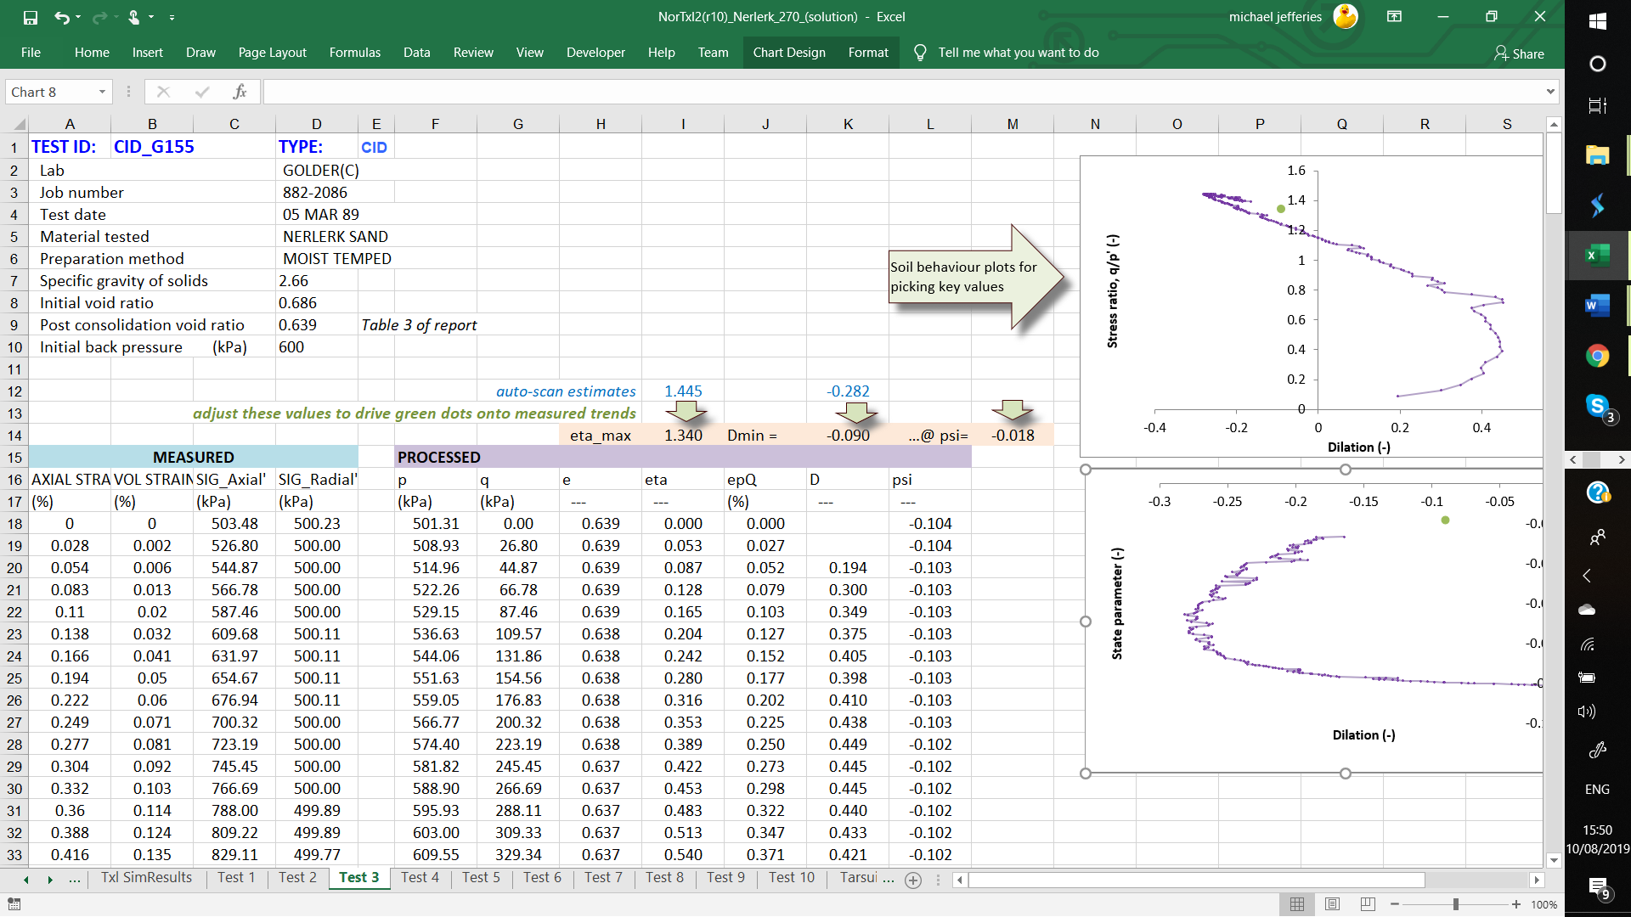
Step 2: Get stress-dilatancy properties
Need numerical differentiation to
fill this column

Slide 52
Numerical differentiation (finite difference)
Forward difference
= (y₃ – y₂) / (x₃ – x₂)
Δy/Δx at 2 ?
3
Central difference
= (y₃ – y₁) / (x₃ – x₁)
2
y
1
= (y₂ – y₁) / (x₂ – x₁)
Backward difference
x

Slide 53
Step 2: Get stress-dilatancy properties
Need numerical differentiation to
fill this column

Slide 54
Step 2: Now you calculate D for Test 3
Numerically differentiate to
fill this column

Slide 55
Why inspect measured data to pick η_{max}, D_{min}
Test 5

Slide 56
Step 2: Get stress-dilatancy properties

Slide 57
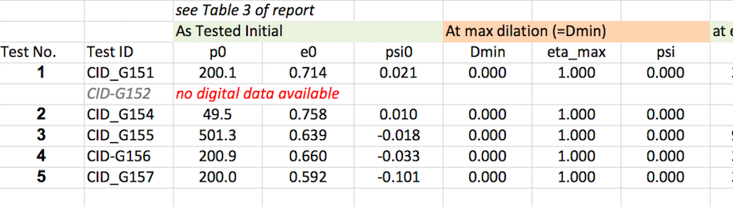
Determine M_{tc}, N_{tc}
Dense Drained Tests
From top line of “data review”
use cell references
Line 14
“Summary & Properties” sheet

Slide 58
Determining M_{tc} and N_{tc}
1
1-N
M_{tc}
“Soil Property Plots” sheet

Slide 59
“Summary & Properties”
These cells reference D_{min}, η_{max} and ψ in the individual tests

Slide 60
Step 3: Get state-dilatancy properties
For automatic updating as CSL is refined, Cell M14 MUST be a column L cell reference
– NOT just the value

Slide 61
State dilatancy – Χ
“Soil Property Plots” sheet
(0.0, 0.0)
Χ
1

Slide 62
Inspecting measured data to pick η_{max}, D_{min}, ψ
Test 5

Slide 63
Now you estimate Μ, Ν and Χ

Slide 64
Job done !

Slide 65
What about clays and silts
Silts
  Same as sand using reconstituted samples
  Drained and undrained loose tests
      M is easy; plot stress-dilatancy of loose drained test for N
      Very difficult to make dense samples with present lab procedures, so need to model a set of test data to get best-estimate of Χ
Clays
  Remoulded samples to get CSL rare
  Tend to rely on isotropic consolidation or oedometers
      Assume CSL similar slope to NCL
  Consolidated undrained tests
      Be very careful of void ratio change from insitu to as-tested
      Model measured behaviour

Slide 66
Important aspects of laboratory testing…
Data archiving
Your role !

Slide 67
Data archiving
You are responsible for proper archiving !
    And keep a copy in your own files…
Many labs submit the lab worksheet as the raw data
    20 MB ? Badly documented ?
    Lab calcs should stay in the lab
Dawn & Mike’s rules: Simple but thorough.
    Use ~3000 points to 20% strain
    Report QA’d: t, σ₁′, σ₃′, ε₁, ε_{v}, e as text file easy import into any software
    Have “header” with details of test including area correction used
    Photo showing deformed shape at end of test
    Add note confirming freezing method for void ratio
    Add note about sample preparation

Slide 68
Your role
You are the engineer !
Make sure properties are reasonably well defined
  Enough tests ?
  Self-consistent trends ?
  Put the entire QA’d data in a single xls ...Nerlerk.xls
  Model to confirm properties
Write-up properly
  Lab data sheets as appendix ?
    Commonly done, but lots of paper and not much insight
    Might be best left in project files
  Better to have your assessment of properties with summary plots

