Slide 1
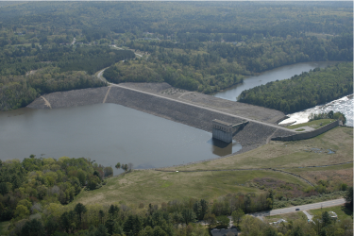
2. Theory of Original Cam Clay (OCC)
Mike Jefferies, PEng
Dr. Dawn Shuttle, PEng
January, 2015

Slide 2
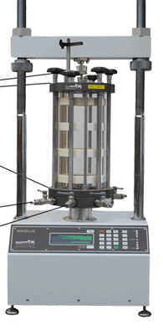
Why theory ?
Looked at soil behaviour from effective stress and drained data
But, what about undrained ?
    Why do pore pressures develop ?
Want to understand how the basic properties
control the stress-strain behaviour
    Effect of void ratio
    Transition into static liquefaction
Need to move from the laboratory to insitu…
    How to we evaluate insitu tests ?

Slide 3
Theory of Plasticity
Greatest contribution to applied mechanics of the 20th century
There is a paper on the history of plasticity theory in the folder ‘Light Reading’
Applies to all materials… steel, copper, pvc, concrete. And soil.
    Understanding how materials deform
Based on some simple ideas that you can observe for yourself

Slide 4
Plastic strains
Applies to all strains
ε = ε^{p} + ε^{e}
Plastic
Elastic
[Tresca, 1884]

Slide 5
Undrained behaviour
Undrained: impose e = constant (thus, no volumetric strain)
Elastic-plastic strain decomposition
Add volumetric elasticity
Effective stress definition:
σ ′= σ − u ➔ dσ ′ = dσ − du

Slide 6
Effect of plasticity in undrained loading

Slide 7
Components of plasticity theory
Yield surface
Flowrule …analogue to Poisson’s Ratio
    Normality
Hardening (and softening) Law …analogue to Young’s Modulus
    Depends on plastic distortional strain increment
Elasticity
    Both within and on yield surface
    Constant ν seems appropriate, G & K = f(e,σ)

Slide 8
Yield surface
σ₁
σ₂
Elasticity
Yield Surface
σ₃

Slide 9
Flow rule (relative amount of plastic strain increments)
Plasticity equivalent of Poisson’s Ratio
Work conjugate
σ₁ δε₁
σ₂
δε₂
Elasticity
σ₃
δε₃

Slide 10
Hardening
Elasticity
Plastic strain
YS changes location
YS changes shape
YS changes size
σ₁ δε₁
σ₂
δε₂
Elasticity
σ₃
δε₃

Slide 11
Consistency
Elasticity
σ₁ δε₁
σ₂
δε₂
Elasticity
σ₃
δε₃

Slide 12
“Normality” (associated flow rule)
P₂ > P₁

Slide 13
“Normality” = Associated Flow Rule
THEOREM

Slide 14
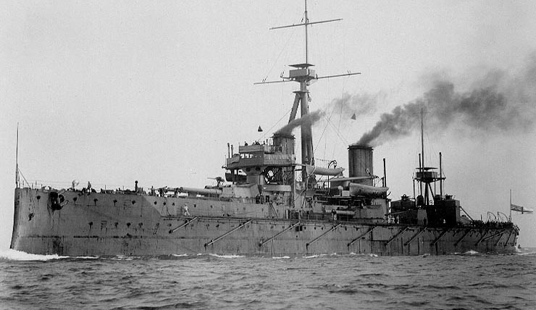
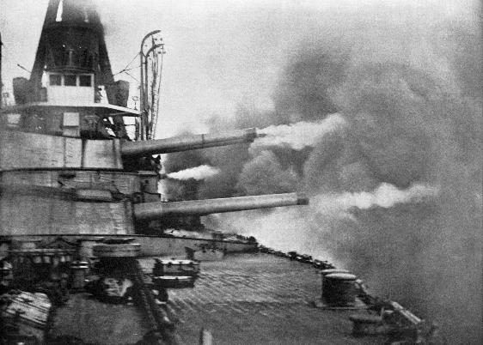
Development of plasticity theory
Soils change volume with distortion
Soil strength and stiffness depends on mean stress
Dreadnought 1906
Plasticity theory introduced to soil mechanics ~ 1945

Slide 15
Appropriate plasticity theory for soils: 1945
Mohr-Coulomb ‘strength’
Elastic

Slide 16
Appropriate plasticity theory for soils: 1950
NAMC
Elastic

Slide 17
Appropriate plasticity theory for soils: 1957
Hvorslev surface
Critical state friction ratio
Oedometer path

Slide 18
Drucker, Gibson & Henkel: 1957 (Conceptual)
Hvorslev surface
Critical state

Slide 19

Math that computes: Original Cam Clay (OCC)
Critical state locus (CSL)
    Semi-log form: Γ, λ
Critical state friction
    Stress ratio: Μ
Elasticity
    Volumetric semi-log form: κ
1968
Convention: Greek symbols used for properties in CSSM
Idealizations (models): named after your local body of water

Slide 20
PROPERTIES: Isotropic compression
Γ
Void ratio
Spacing Ratio = p_{icl} / p_{csl}
c_{c}
λ₁₀
Mean effective stress, p’: kPa

Slide 21
PROPERTIES: Elasticity
Void ratio
c_{c}
c_{s,r}
Mean effective stress, p’: kPa

Slide 22
Log10 versus Ln
Used in theory (ln)
What the lab reports (log)
CSL: e_{c}= Γ − λ ln(p’)
Elasticity: de = κ dp′ / p ′
CSL: e_{c}= Γ − λ₁₀ log(p’)
Elasticity: Δe = c_{r} log( p_{old} / p_{new})
λ = λ₁₀ / 2.3 κ = c_{r} / 2.3

Slide 23
PROPERTIES: Critical Friction Ratio
Deviator stress, q: kPa
Mean effective stress, p’: kPa

Slide 24
Basis of Original Cam Clay
Postulates
    Simple physical idealizations
    Inspired by test data, but do not depend on data to justify
Consistent and formal mathematics
At the end discuss “utility” of OCC by looking at how well the theory explains what we observe/measure

Slide 25
Derive the OCC flowrule
Consider a unit volume element of soil loaded by a strain increment...
σ₁
σ₁+Δσ₁
σ₂ , σ₃
σ₂ , σ₃
Work:

Slide 26
Plastic work dissipated by soil skeleton
Use elastic-plastic strain decomposition:
ΔW^{p} = ΔW – ΔW^{e} = q Δε_{q}^{p} + p Δε_{v}^{p}
Divide this plastic work rate first by the mean effective stress
(to make it dimensionless);
Divide by the plastic shear strain increment
(normalized rate of working per unit plastic distortion of the soil)...
Normalized rate of dissipation of plastic work (into heat)
ΔW^{p}/(p Δε_{q}^{p} ) = q / p + Δε_{v}^{p}/Δε_{q}^{p} = η + D^{p}
Stress-dilatancy
“universally acknowledged truth” (no constitutive model)

Slide 27
The OCC idealization
Postulate:
(model)
Universally known truth:
Flowrule
(Stress-Dilatancy)

Slide 28
“Normality” = Associated Flow Rule
THEOREM
dε_{q}^{p}
dε_{q}^{p}
D^{p} =dε_{v}^{p} / dε_{q}^{p}
Δq
dε_{v}^{p}
Δp
dε_{v}^{p}

Slide 29
High-school geometry...
X
- 1 /X
Invoke normality:
dp/dq = - 1/D^{p}

Slide 30
Getting to YS: a bit of math...
Definition... q = η p
Differentiate... dq = p dη + η dp
Eliminate dq.. dq = - dp D^{p} from normality
- dp D = p dη + η dp
dp /p + dη / (D+η) = 0

Slide 31
Derivation of OCC yield surface
From normality...
From plastic working...
M = D^{p} + η
Combine...
ln(p) + η/M = C
And integrate...

Slide 32
Choice of integration term “C”
D = 0
Μ
p_{c}

Slide 33

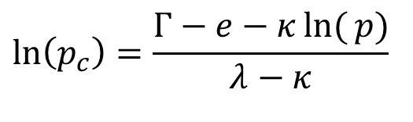
How does void ratio control strength ?
e
λ
κ
ln(p)
Notes:
Substitute for pc in 1-eta/M = ln(p/pc)

Slide 34

OCC – the equations
Yield surface:
Flowrule:
Hardening:
Elasticity:
Normality & Work
Work
CSL
$$G=∞$$
Only 4 soil properties… Γ, λ, κ, Μ

Slide 35
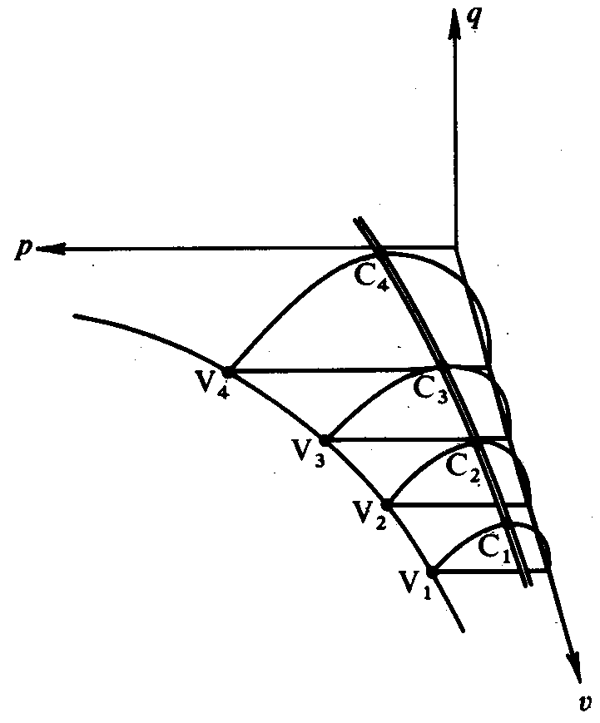
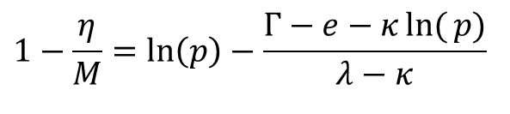
“state boundary surface”
Barking mad view !
And where is plastic strain ?
Combine yield surface with hardening law
=1+e

Slide 36
Let us do hardening properly…
void ratio, e
CSL
A
de^{p} = − (λ− κ) dp_{c} / p_{c}
Plastic void ratio change
κ
B
λ
ln(p)

Slide 37
Strain-induced hardening…
Plastic void ratio change:
Strain to void ratio……
PLASTIC HARDENING:
de^{p} = − (λ− κ) dp_{c} / p_{c}
H

Slide 38
Consistency condition
Stresses must remain on yield surface during plastic yield
Hardening Law

Slide 39
Standard ideas for consistency
Yield surface: F(σ, e, ζ...) = 0
    If F < 0 then ‘elastic’
    If F=0 then ‘plastic’
    F>0 not admissible
CONSISTENCY CONDITION
    Must remain on the yield surface during yielding
    mathematically: dF = 0
Rewrite OCC yield surface as:

Slide 40
Consistency condition for OCC
For yield surface written as F=0, consistency is dF=0
Loading path
Hardening Law
Use with...

Slide 41
Consistency in undrained yielding

Slide 42

OCC – the equations
Flowrule:
Hardening:
Consistency:
Elasticity:
Work
CSL
Normality
& Work
$$G=∞$$
Only 4 soil properties… Γ, λ, κ, Μ

Slide 43
EXERCISE 2: Compute undrained OCC
Folder ‘Exercise Templates’: OCC_CIU_EX2_template.xls
Compute q vs ε and p-q
Compare with closed-form

Slide 44
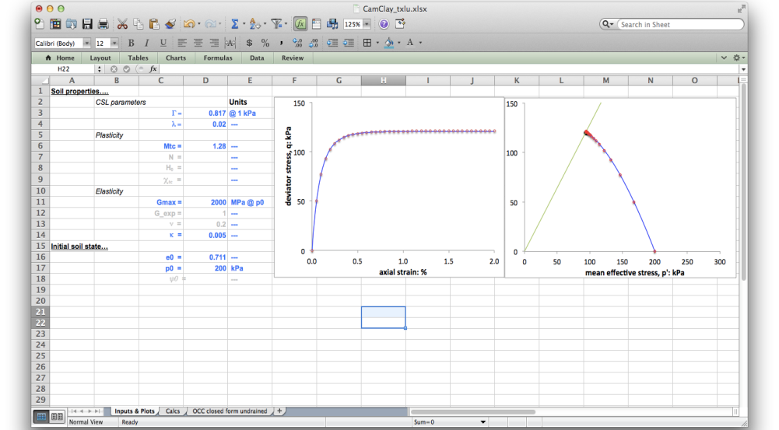
OCC_CIU_EX2.xls

Slide 45
Integration: how ?
OCC is incremental:
    How does p_{c} change with strain ?
    Where is the stress state on the yield surface ?
No closed form solutions in CSSM (mostly)…. NUMERICS
General situations
    stress, strain, state varies across loaded body
    finite element or finite differences
Laboratory tests
    “element” tests with soil at “uniform” stress and strain state
    stress or strain paths controlled by test arrangement (txl : Δq= 3 Δp)
    allows direct numerical integration of plasticity model

Slide 46
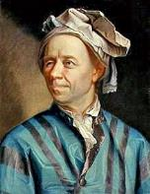
Euler basics – what your xls will do…
1748

Slide 47
Integration loop
Get state variables … G, K, M_{i} depend on (e, σ)
(ε_{q}^{p})_{NEW}= (ε_{q}^{p})_{OLD} + Δε_{q}^{p} … step forward plastic strain step
Apply flowrule => Δε_{v}^{p} … the other strain increment
Harden yield surface ... yield surface changes size
Find new stress state … depends on stress path
Add elastic strain incs
Update e
Repeat until done

Slide 48

The Integration “Loop”
End of one step becomes start for the next

Slide 49
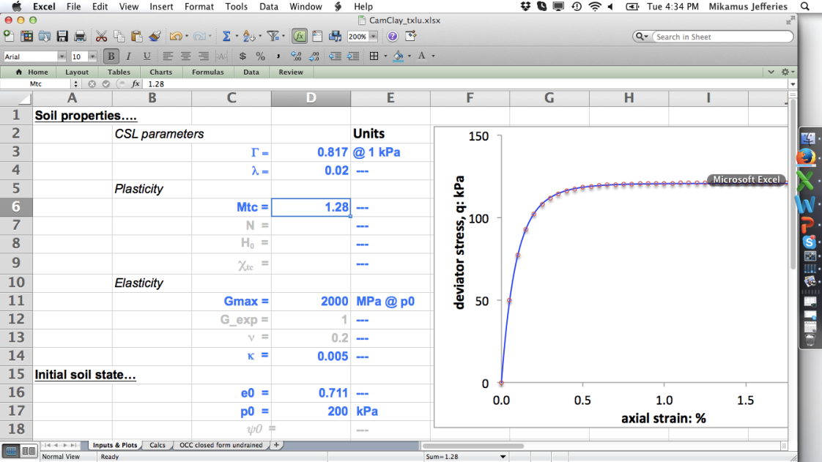
Use ‘named’ variables for properties

Slide 50

Soil Property Inputs
κ = λ /4

Slide 51

Initial void ratio for isotropic test…

Slide 52
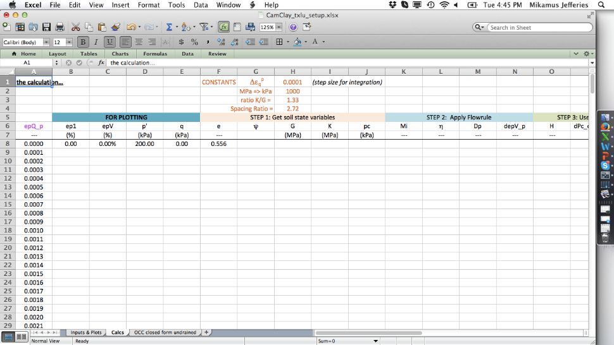
Initial size of the yield surface (isotropic)

Slide 53
Getting units correct
People need information presented in familiar forms
    Avoids errors !
    For engineers, allows instinctive reality checks
    The templates you will use follow this protocol
Equations must be in consistent units
    Some inputs in MPa but calculate throughout in kPa
    Make unit conversions explicit

Slide 54
Unit conversion…
MPa_to_kPa

Slide 55
Verification and Validation
Verification: does the numerical model compute correctly ?
    Compare numerical solution with a reference solution
    Reference solution ideally closed form (but very few of them)
    Cannot verify numerical methods by laboratory testing
Validation: does the verified model have any relevance to engineering reality ?
    Compare model with a body of laboratory test data…
    Back-analysis of case-histories (but rarely know enough…)

Slide 56

Verification of OCC implementation
http://www.geotechnique.info/
  Chapter 6 in workshop info files
OCC has two closed form solutions
    Constant-p CID for NC soil
    Undrained CIU for NC soil
Use published solution without derivation
Solution in Section 6.7
    Implicit
    Need to use 3 equations

Slide 57
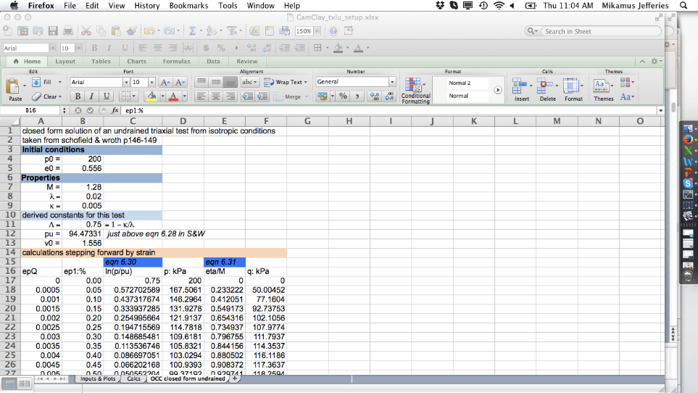
OCC solution for CIU test on NC soil

Slide 58
Verification result… perfection
Numerical using Euler integration
Closed form S&W Sect 6.7

Slide 59
Intergation sequence in the worksheet
equations in the hand-out !

Slide 60
Your turn !
This is the hardest part of this course…

Slide 61
OCC – the equations
Flowrule:
Hardening:
Consistency:
Elasticity:
Work
CSL
H
Normality
& Work
G = 2000 MPa
Only 4 soil properties… Γ, λ, κ, Μ

Slide 62


OCC – the equations
Yield surface:
Flowrule:
Hardening:
Elasticity:
Undrained: dp = - K dε_{v}^{p}
Normality & Work
Work
CSL
H
$$G=∞$$

