Slide 1
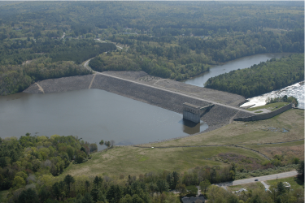
3. Drained txl compression of OCC
‘consistency condition’
Mike Jefferies, PEng
Dr. Dawn Shuttle, PEng
January, 2015

Slide 2
Consistency condition
NEED TO KNOW LOADING PATH TO
INTEGRATE
Hardening Law
3

Slide 3
Consistency in drained triaxial
1. Differentiate η = q/p
3
2: Use consistency condition

Slide 4
EXERCISE 3a: Modifying xls from CIU to CID
Make copy of undrained worksheet which you then edit for drained test
Stress-path plot
    Delete the undrained closed-form solution
    Add the theoretical stress path for drained triaxial compression
    (use red dots again)
Modify
    Calc of Δp
    Load path already defined on sheet (check dq/dp = 3)

Slide 5
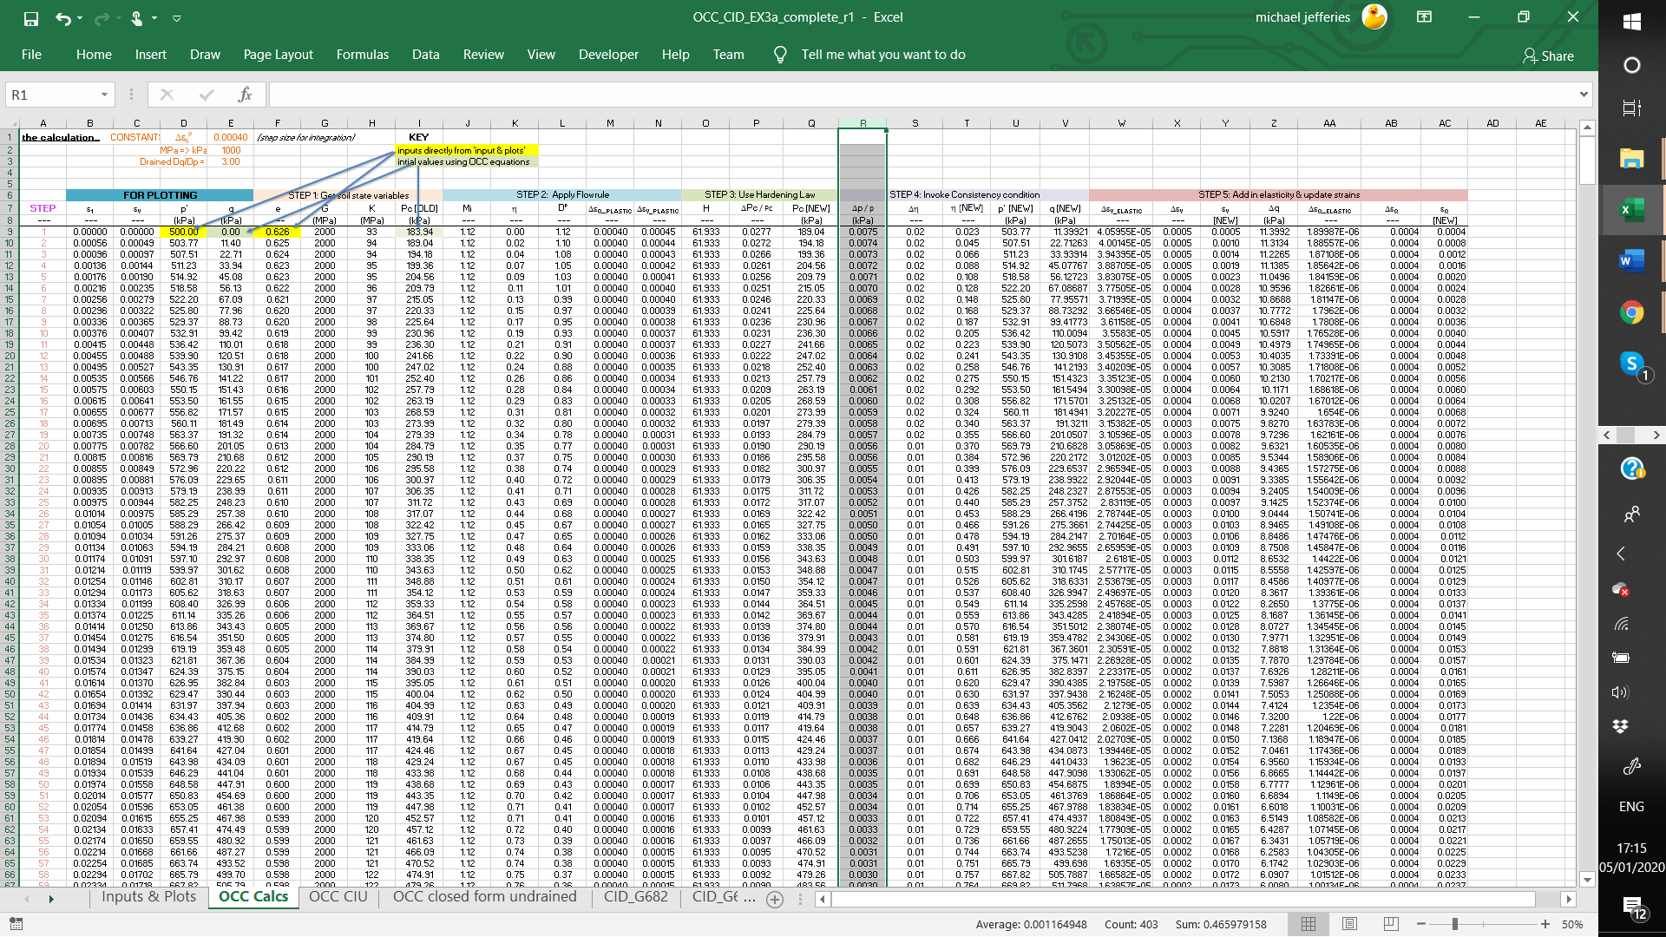
Drained OCC… xls modifications
Modify to drained path

Slide 6
Computed soil response

Slide 7
Let us program….
(validation then follows)

Slide 8
Validation of OCC
Find sheet CID_682 in spreadsheet
Plot ep1 vs q & epV vs ep1 on same plots as OCC
p₀ = 500 kPa; fix plot scales
Adjust OCC properties to fit data
No single “right” answer… it is now a matter of
engineering judgement as to what is “reasonable”

Slide 9
My fit to test
Γ = 0.93
λ = 0.03
κ = 0.007
Μ =1.15
Erksak CID-682
Original Cam Clay

Slide 10
The “error” of Cam Clay

Slide 11
EXERCISE 3b: The trouble with OCC…
Switch data to plot from worksheet 682 to 667
    This is a dense test on Erksak sand
    Sample just gently tapped during pluviation
Set OCC properties to match this test and sand tested…
    p₀ = 130 kPa
    Γ = 0.816
    λ = 0.015
    κ = λ / 4
    Μ =1.27
    e₀=0.754

Slide 12
Worksheet plots with CID_667 imported
Now try and honour the measured initial void ratio in this test…
SET: 1) StepSize much smaller…. 0.00002
2) e₀ = 0.587

Slide 13
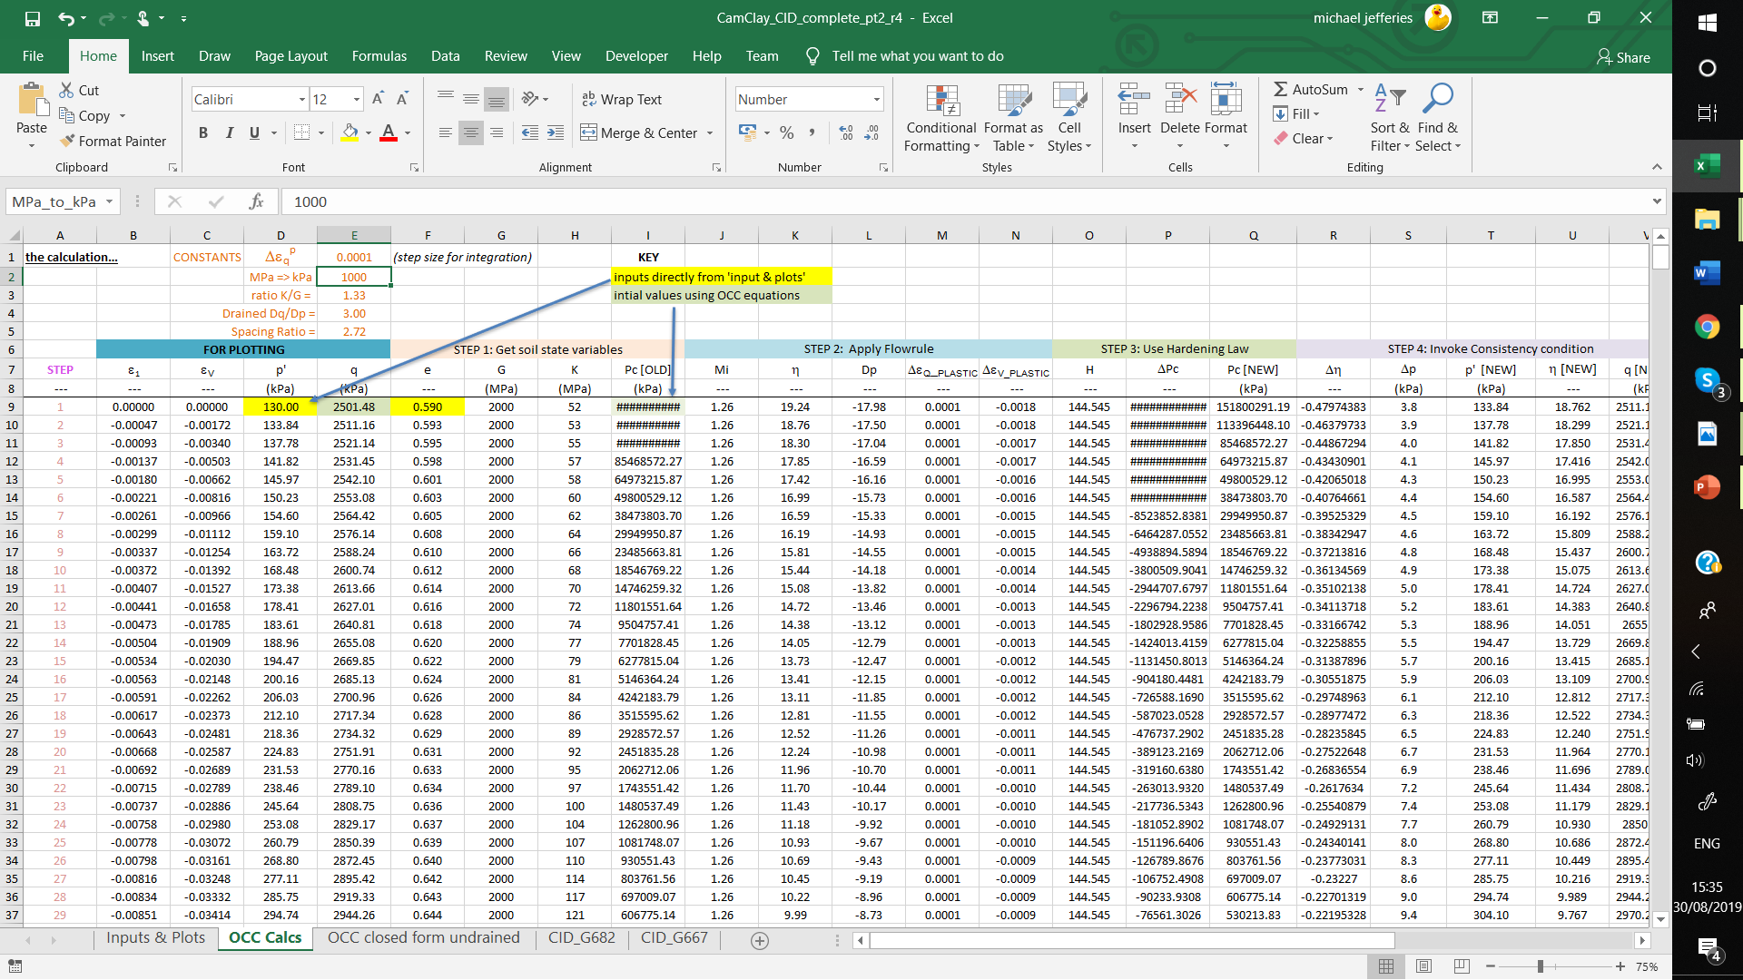
Look at the stresses !

Slide 14
What is going on ?
Void ratio
c_{c}
Apparent OCR
Mean effective stress, p’: kPa

Slide 15
Zone of OCC applicability
Void ratio
c_{c}
OCC not too bad
NAMC
CSSM
Mean effective stress, p’: kPa

Slide 16

World view of CSSM: Wikipedia
..only able to model "simple stress-strain curves” from isotropic normally or lightly over consolidated clays..
..very poor matches of these models to volume changes or pore pressure changes..
a “degenerate research program”.. ..where excuses are used to justify an inability of theory to match empirical data

Slide 17
Summary
OCC is beautiful mathematical construct
Validates to real soil under very limited range of conditions
OCC cannot deal with nearly everything encountered in practice
    Excessive and unrealistic sensitivity to void ratio
Situation ~ 1975: “ Interesting, but CSSM a dead end ”
GAME CHANGER….
1985: State Parameter (Parry, 1958)
1993: NorSand

