Slide 1
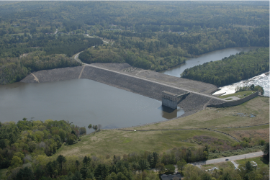
4. CSSM done properly
Mike Jefferies, PEng
Dr. Dawn Shuttle, PEng
January, 2015

Slide 2
Basic premise of Cam Clay (OCC & MCC)
e
ln(p)
Notes:
Substitute for pc in 1-eta/M = ln(p/pc)

Slide 3
Dense soil in OCC
Void ratio
c_{c}
Apparent OCR
Mean effective stress, p’: kPa

Slide 4
Historical basis of CSSM
1885 – dilation is a fundamental soil behaviour Manchester
1935 – critical state as limit of dilation behaviour Harvard
1940 – critical state locus MIT
1950 – work basis of stress-dilatancy Imperial
1951 – THEOREM theromodynamics ➔ plasticity Brown
1955 – critical state of clay Imperial
1957 – correct form of associated plasticity for soils Brown / Imperial
1962 – stress-dilatancy applies everywhere Manchester
1968 – first proper model: Original Cam Clay Cambridge / Brown
1969 – how to measure CSL reliably Harvard
1990 – generalized for real soils Gulf Canada Resources

Slide 5
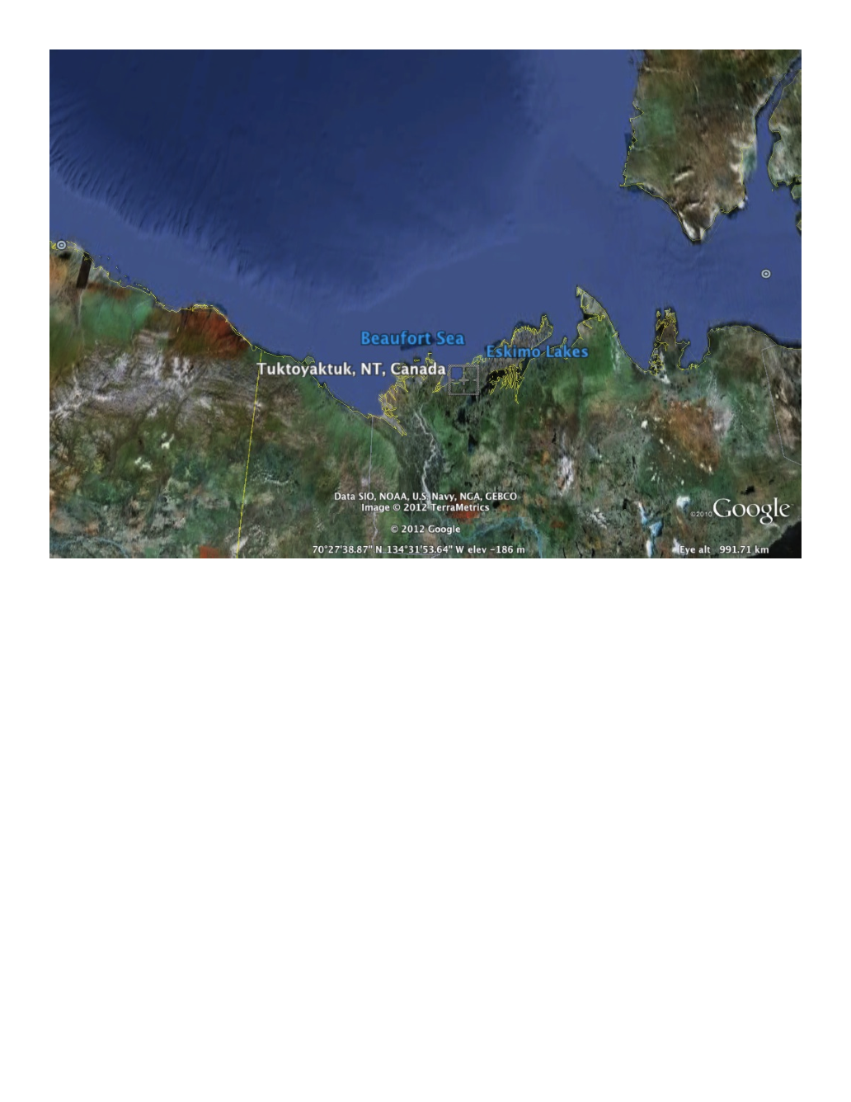
100 year history of mechanics…
can “the math” be that wrong ?

Slide 6



Slide 7
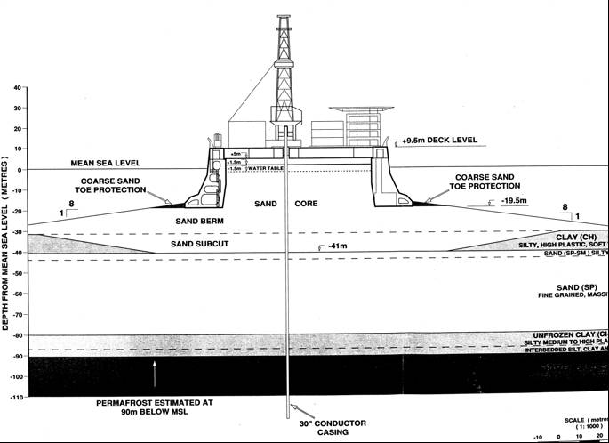

Slide 8
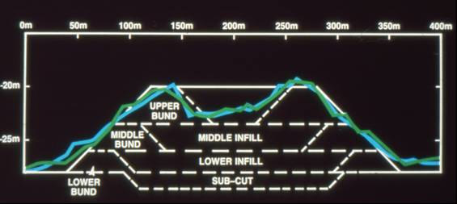
Berms details

Slide 9



Constructing the berm…

Slide 10
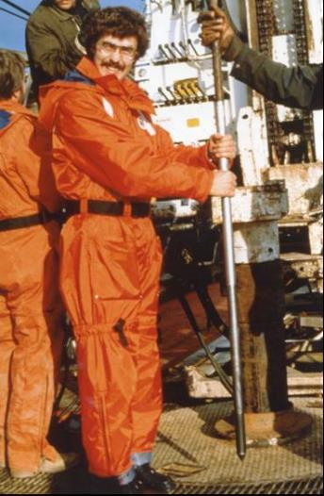
CPT resistance in hydraulically placed sand

Slide 11
Void ratio from the CPT

Slide 12
And now re-plot in familiar form…
Normally
consolidated hydraulic fill

Slide 13
Soil behaviour in isotropic compression

Slide 14
Soil behaviour in isotropic compression

Slide 15
ICL versus CSL
Extensive testing: Unique CSL

Slide 16
O’Tooles corollary to Murphy’s Law
NOT CRITICAL STATE
Plastic work
e
p_{i}
ln(p)
Image condition… D^{p} = 0
(at critical: ΔD^{p}/Δε_{q}=0)
aka ‘pseudo steady state’
‘phase change state’
Notes:
Substitute for pc in 1-eta/M = ln(p/pc)

Slide 17
AXIOMS (fundamental assumptions)
  Axiom 1: Unique CSL
Axiom 2:
ψ ➔0 as ε_{q} ➔∞
ψ
Mathematical statements that do not depend on soil test data

Slide 18
CSSM FIX STEP 1: Yielding to CS
Critical state
D = 0 & dD/dε_{q}= 0
Axiom 2
ψ => 0
M
Distortional strain ε_{q}
Image condition
D = 0 & dD/dε_{q}<>0

Slide 19
CSSM FIX STEP 2: Limit dilation
Hvorslev surface
D_{min} = χ_{tc} ψ
p_{mx}= p exp(−χ ψ /Μ)

Slide 20
Combine the fixes: NorSand

Slide 21
Internal cap: yield in unloading
D_{min} = χ ψ
Elastic stress path

Slide 22
Yield in unloading
Elastic
Plastic yielding

Slide 23
Original Cam Clay vs NorSand
 | OCC | NS
Flowrule
Yield Surface
Hardening
Elasticity | ; G = ∞ | G = measured ; ν = constant

Slide 24
Original Cam Clay vs NorSand
 | OCC | NS
Critical State | Γ, λ, Μ | Γ, λ, Μ
Dilatancy | --- | Ν, Χ
Hardening | --- | Η
Elasticity | κ | G , ν
Need not be semi-log

Slide 25
TUTORIAL 4: Change OCC to NS
Make additional soil properties ‘live’: H, X, G_{max},ν
    Revise calculation of K using ν
FIX initial conditions: q₀ and P_{im, 0}
ADD in: state parameter, ψ ; hardening limit, P_{mx}
RENAME: P_{c} => P_{im} and ΔP_{c} => ΔP_{im}
MODIFY hardening law; H; K; step-size

Slide 26
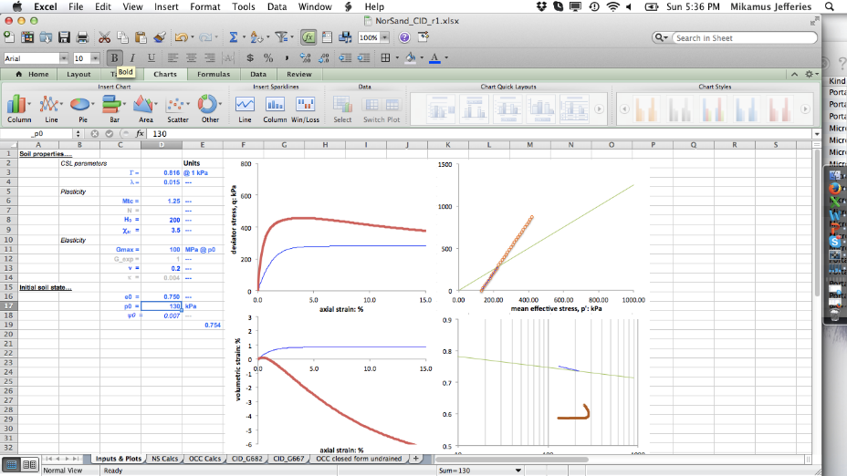
Make additional soil properties “live”

Slide 27
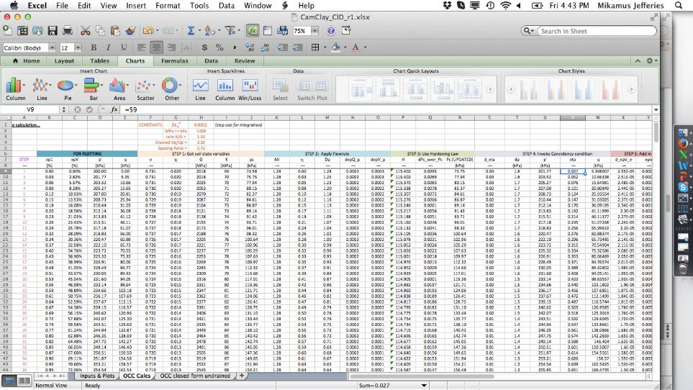
FIX initial conditions
P_{i}
Set q₀ = 0
Use yield surface equation:
P_{i0} = p₀ exp (η /M - 1)

Slide 28
ADD new variables
p_{mx}
ψ added

Slide 29
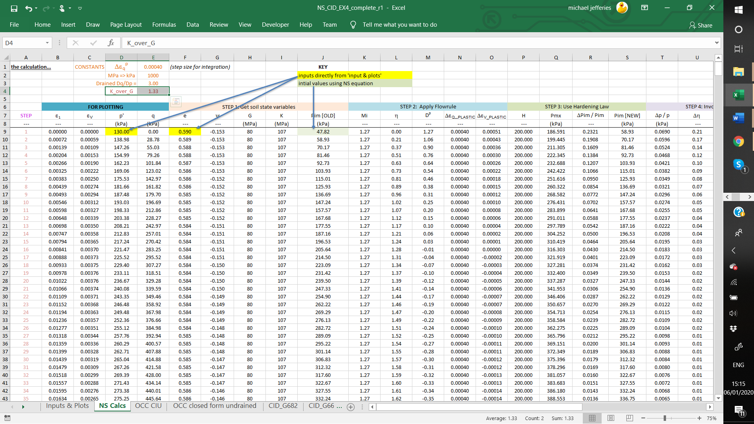
MODIFY calculations to NS

Slide 30
Computed soil response for simple NS

Slide 31
Over to you: Save !
Save your OCC_CID_EX3.xls
‘Save As’ NS_CID_EX4.xls to make copy you will use
Rename the sheet ‘OCC Calcs’ to ‘NS Calcs’

Slide 32
Let’s get NorSand working
(and then we will tweak)

Slide 33
Over to you
Add in …
    Soil properties H = 200, Χ = 3.5, Gmax = 80 MPa, ν = 0.2
    Column for p_{mx}
    Calculation for ψ
Modify
    Column labels
    Set: p_{img} initial = p₀ exp( η /M-1)
    Calc of Δp_{im} / p_{im} (using new hardening law)
    Calc of H ( now just a constant)
    Calc of K (see top of sheet)

Slide 34
Tweaks
There is an element of shear hardening when matching pure theory to data
    FIX: H = H p / p_{img}
The coefficient ‘M’ (or φ_{c}) is not a constant in
stress-dilatancy theory
    Known since ~1963 (Bishop talking about this in 1950)
    Dafalias 1997 suggests M(ψ)
    Nova’s flowrule best for peak strength…
    η = M – (1-N)D^{p}
    FIX: M_{i} = min(M, M + N χ ψ)

Slide 35
Fit to test

Slide 36
“Horses for courses”
British Establishment View
    OCC “fine for soft clays”
    NS “best in class” for sands
CSSM
  Based on axioms and derivations
  No specification or role for soil gradation (or fines… )
  “clay” is just a different set of soil properties from “sand”
OCC is a specific (degenerate) case of NS
    N = 0
    ψ₀ = λ−κ
    H = 1/(λ−κ)
    G = large number & derive K from κ

Slide 37
OCC as special case of NS
See J&B Append H in workshop notes

Slide 38
Over-consolidation
Geological: the ratio of greatest vertical effective stress in the soil’s history to the current vertical effective stress
Mechanics: how far inside the yield surface you are
Yield in unloading partially wipes out memory of maximum past stress
If inside yield surface, only have elastic strains = vertical stress path

Slide 39
Over-consolidation
OCR

Slide 40
Definition of OCR
OCR = p_{img} / p_{img}

Slide 41
Example of OCR in data

Slide 42
Time to become engineers

