Slide 1
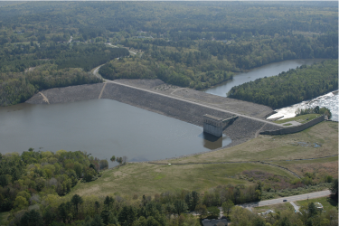
6. ‘Industrial Quality’ NorSand (VBA)
Dr. Dawn Shuttle, PEng
Mike Jefferies, PEng
January, 2015

Slide 2
Soil mechanics has to wait 30 mins…
You are now at the limit of what should be done in Excel
worksheets. We now need to do things as an engineer…
Need to know some VBA techniques
Packaged for you in “open code”
Quickly overview VBA and then you jump in…

Slide 3
Bad practice – prevalent in geotech !
Programming equations in a worksheet is like writing computer code from the 1960’s… what does a variable named “C3” stand for ?
Modern computer languages evolved to use “plain english” variables for both readability and maintainability… “C3” => “eta_max”
Modern languages also allow comments adjacent to variable names for enhanced readability…. ‘eta_max as per eqn 6.73”
Microsoft has provided a series of cheap, easy to use languages
    Quick Basic QB45 (ye olde DOS days)
    Visual Basic VB3 (Windows 3.11)
    Now bundle an ‘integrated development environment’ with Office: VBA

Slide 4
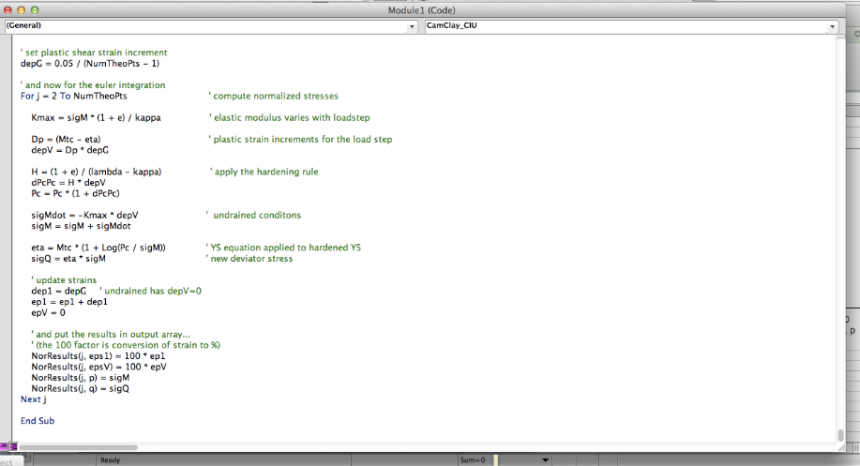
VBA Code for OCC

Slide 5

VBA reference

Slide 6
Load program
Find your work from Exercise 1
Open NorTxl2(r10)_Nerlerk_270.xls
  ‘Enable Macros’ when opening !

Slide 7
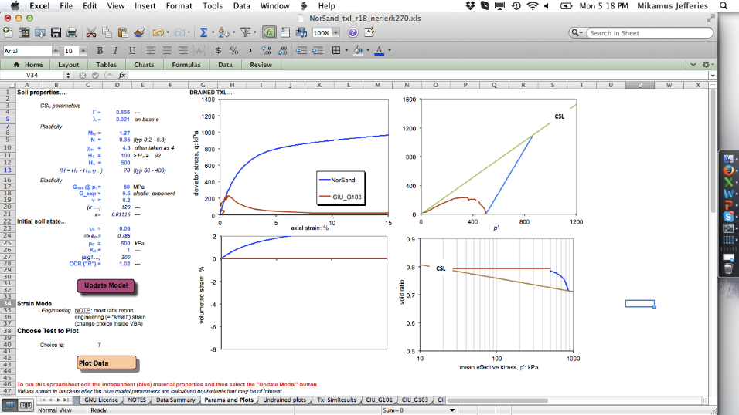
Modelling interface
Use to simulate with NorSand
Use to look at a test

Slide 8
Structure of VBA Program
On button click…
  Get values from Params & Plots worksheet
  Clear output worksheet
  Do all the clever things all in VBA (subroutines and functions)
  Put results in single master array
  Image that array back to excel worksheet Txl SimResults
  Excel graphs plotted from output worksheet in Params & Plots

Slide 9
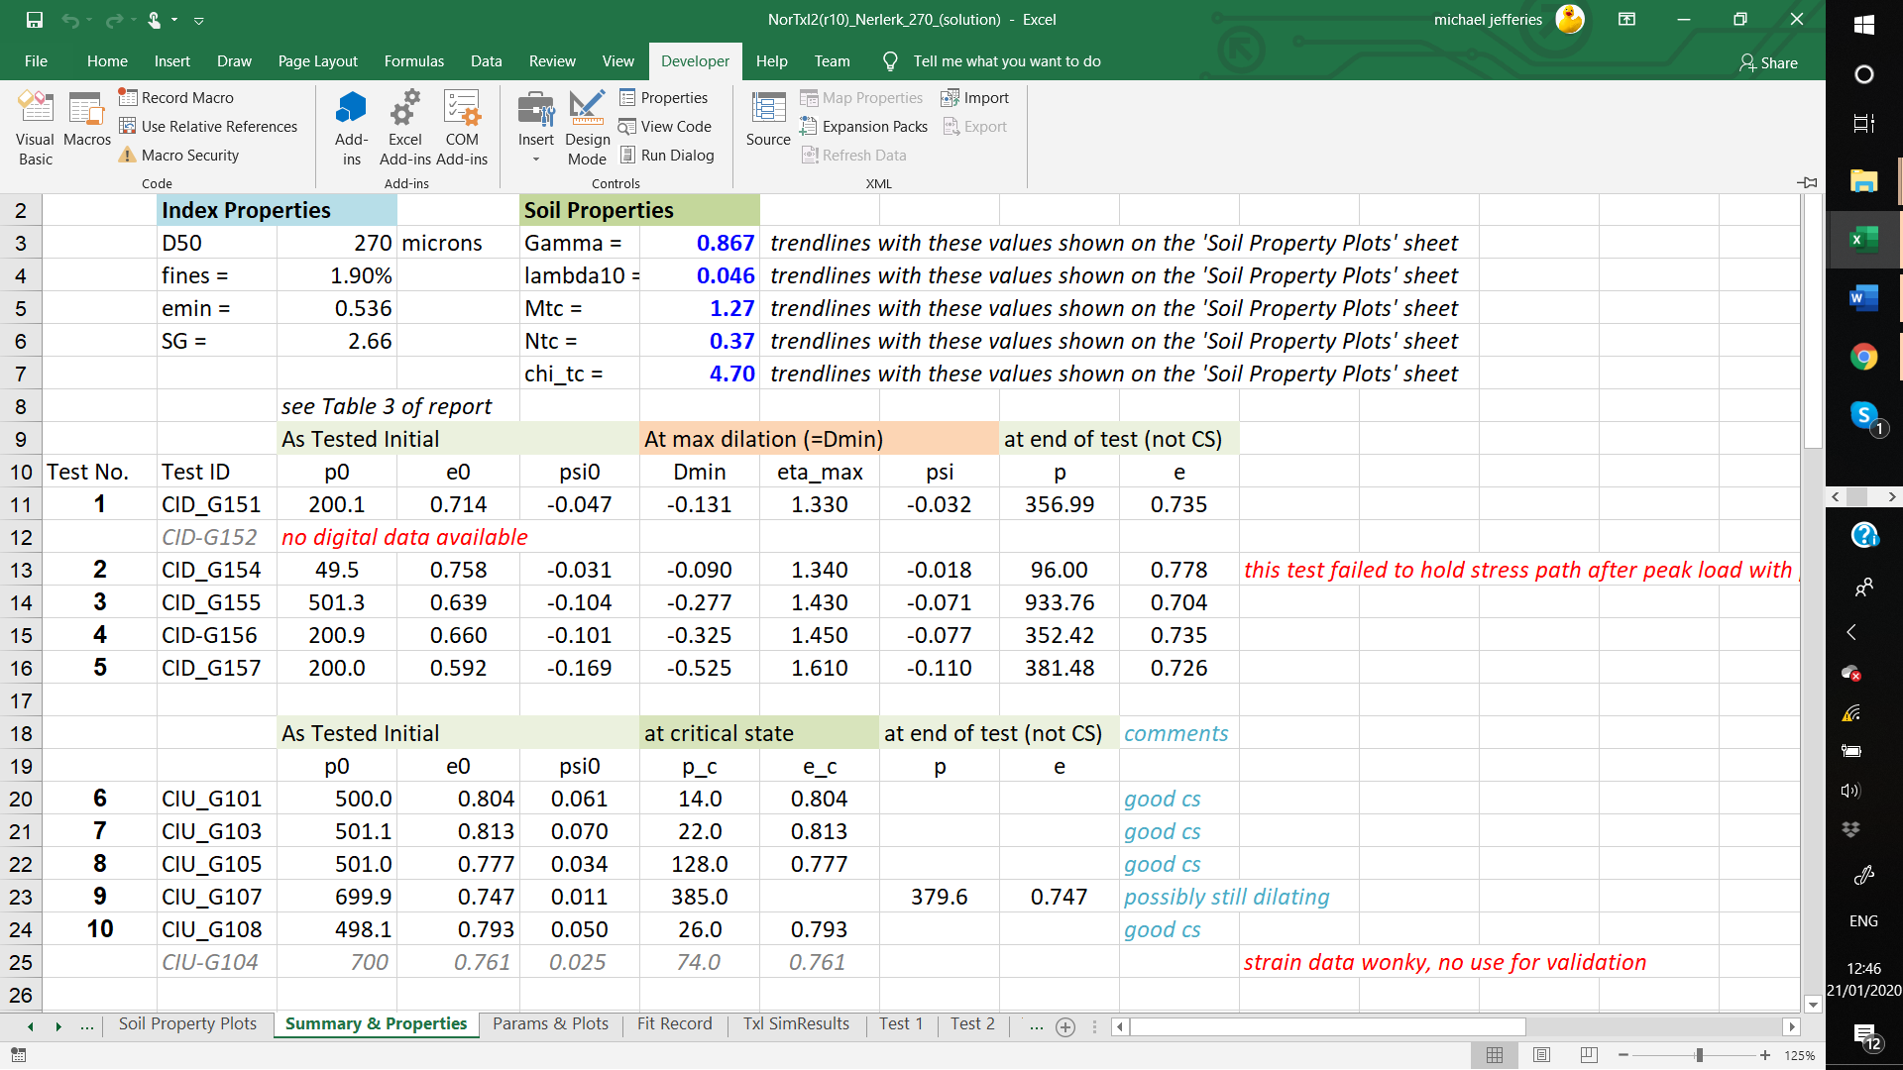
Accessing VBA : Developer (“Alt” +”F11”)
“Enable Macros”
Notes:
Substitute for pc in 1-eta/M = ln(p/pc)

Slide 10
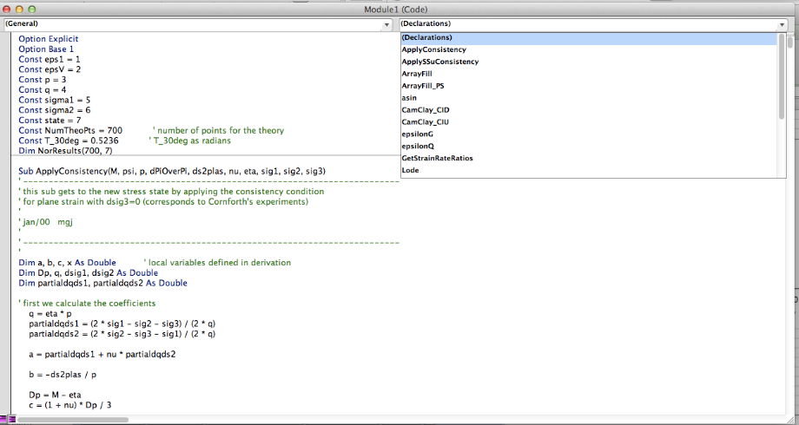
VBA code

Slide 11
Functions vs Subroutines
Functions return a single value based on their input values
    Function Mi (Mc, chi, lode, psi)
    Function e_crit(sigM,….)
Subroutines do not return anything... Results held in variables
    Used for most of the critical state modelling

Slide 12
My bad programming practice…
ComSci disciples like “encapsulation”
    Everything used in a function/subroutine is passed to in in the “call”
    Very “safe” programming practice
    But, leads to very long winded code to read
    StrainRates (ep1, ep2,ep3, sig1, sig2, sig3, NorProp(), Dp, z2, z3)
Global variable allow easy, english-like code
    GetPlasticStrainRates
    Inputs, properties, outputs must be held “globally”
    Accessible to any routine
    But, can be modified by any routine (accidentally…)

Slide 13
EXERCISE 5 – NorSand Calibration
Learn to calibrate NorSand
  Use Nerlerk 270 as the example
  Properties as per your values in Exercise 1
  Now think about drained stiffness and all the undrained behaviour
  Understand how G_{max} affects undrained behaviour
Learn to modify NorSand
  NS is a framework with options
  M_{mobilized} is an open issue in Geotech
  CSL can have different forms

Slide 14
NorSand Calibration - Purpose
Purpose of the calibration ?
  Subsequently getting accurate ψ from CPT
  Engineering ‘hand’ calculations (e.g. s_{u} /σ_{v0} for stability analyses)
  FE / FD analysis
What’s NOT the purpose of the calibration ?
  Getting a fantastic match between the experimental and theoretical curves for a single test – if this calibration is not representative of the majority of tests…

Slide 15
NorSand Calibration - Purpose
A SINGLE SET of material properties is required
Already calibrated in Exercise 1: Γ, λ, Μ, Ν, Χ
Same properties should fit all of the tests reasonably well
    Where necessary bias your “best” fits to in situ conditions
    Flag exceptions for further consideration
Open for calibration:
    Plastic hardening H
    Elastic shear modulus: G
    Actual state parameter of test (laboratory testing error)
This requires ENGINEERING JUDGMENT…….
and while you’ll find silly fits exist, there is no unique “correct” fit.

Slide 16
Nerlerk Data “Summary & Properties”
…from Exercise 1

Slide 17
Modelling drained tests
3: Vary H₀ to fit test
2: Elastic properties – set from geophysical data
1: ‘state’ variables – choose for test initial conditions
minor change in ψ from lab value ok

Slide 18
1: Choosing initial state variables……
Δψ₀ ± 0.02
small changes to ψ₀ allowed
η₀ = 0.0 for these tests
may increase OCR
for CIU if needed

Slide 19
2: Nerlerk elastic shear modulus

Slide 20
3: Calibration – fitting H…
First pass choose H_{ψ} = 0

Slide 21
Example fit of NorSand drained compression

Slide 22
NorSand Calibration – finally to H……

Slide 23
NorSand Calibration – H
On “Summary & Properties” sheet
Paste in as “values only”
Note that below this paste there is a track on Δψ₀ and a plot of Δψ₀ vs. p’

Slide 24
Bias check on ψ testing error
Δψ₀ ± 0.02
Accuracy from water content measurement by ASTM procedures
Bias in error with p′ = sub-optimal CSL

Slide 25
Calibration procedure: drained tests
Start with drained tests
Best-fit each in turn
Copy fit-parameters to ‘summary’ so you can see trends emerging
Keep copy of your fit using ‘paste special’ + ‘enhanced metafile’
When happy with drained move to undrained
    Must retain H trend from drained
    G_{max} open to question

Slide 26
Example calibration result and trends
Trend line fitted using H₀, Hψ

Slide 27
Over to you to calibrate drained tests Tests 1 - 5

Slide 28
Undrained Tests…
G_{max} and OCR

Slide 29
Modelling undrained tests
2: Use H trend from drained calibration to start
3: Vary G_{max} to fit stress-path and brittleness
1: ‘state’ variables – choose for test initial conditions
minor change in ψ from lab value ok

Slide 30
Effect of G_{max}
Using G_{max} from geophysics
Using G < G_{max} to fit test

Slide 31
It is not actually G_{max} that is the issue…
Undrained condition in elastic-plastic decomposition
  .
  Isotropic elasticity
Options
  Accept too brittle behaviour and use G_{max}
  Reduce G_{max} to fit data
  Reduce Poisson’s ratio to fit data
κ / λ ~ 0.25

Slide 32
Isotropic compression of Erksak sand
K = p (1+e) / κ
κ / λ = 0.36
κ / λ = 0.25
κ ...is unload-reload behaviour in oedometer or triaxial
κ / λ = 0.27
κ / λ = 0.38

Slide 33
Elastic relations (isotropic)
G = K (3 – 6ν) /(2 + 2ν)

Slide 34
THE PROBLEM: Sands
I_{R} = G_{max} / p
G from κ elasticity

Slide 35
THE PROBLEM: Silts
I_{R} = G_{max} / p
κ elasticity

Slide 36
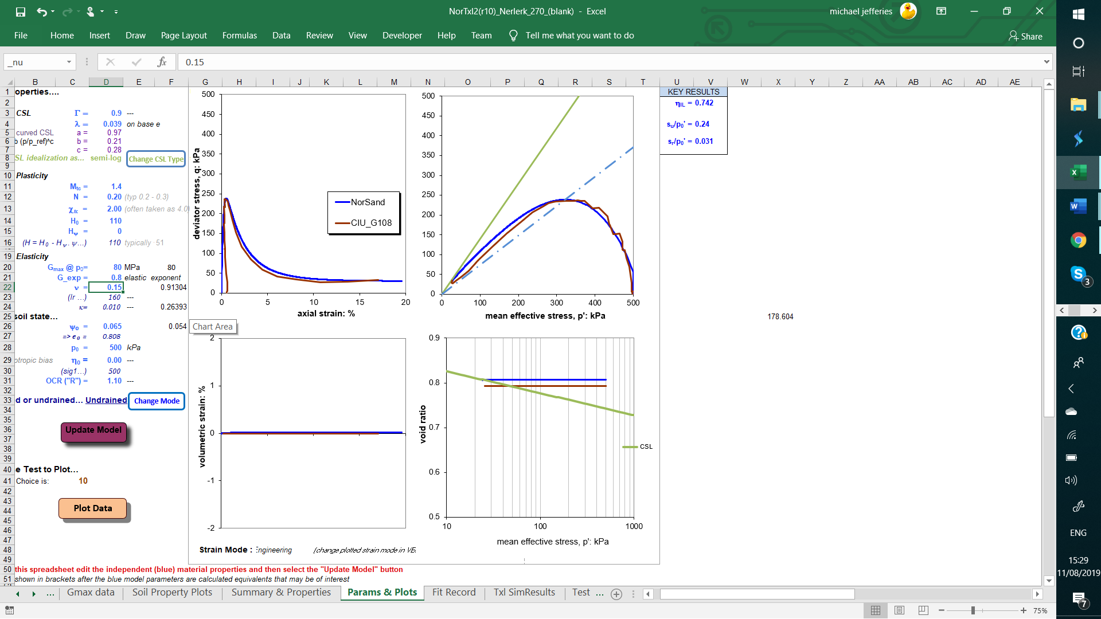
Typically κ/λ circa 0.25 – adjust using G_{max}
κ / λ

Slide 37
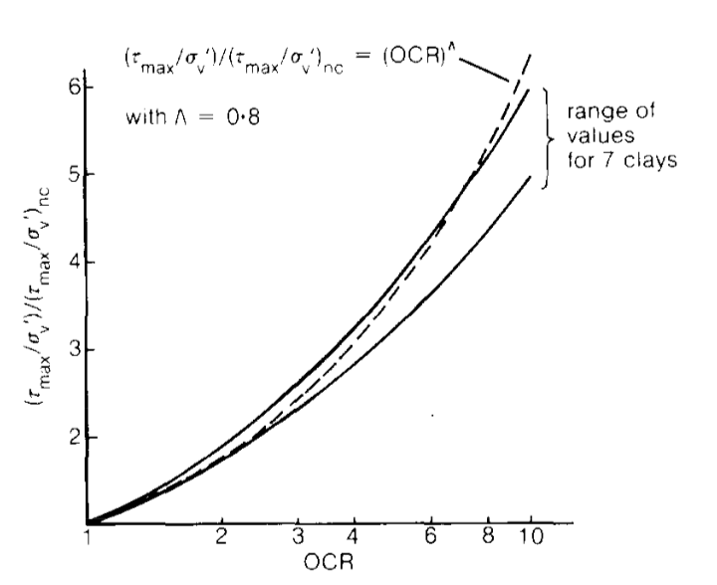
Wroth has the same κ/λ...
Λ = (λ-κ)/λ

Slide 38
ELASTICITY: HOW TO PROCEED
Calibrating to laboratory tests
  CID tests… use G = G_{max}
  CIU data to refine G_{max} with ν = 0.15 (0.2 ?)
      Adjust… G ~ G_{max} / 3
      Engineering Kludge as there is deficient current knowledge
      Need to learn what fudge works for the soil in question

Slide 39
Over-consolidation
Geological: the ratio of greatest vertical effective stress in the soil’s history to the current vertical effective stress
Mechanics: how far inside the yield surface you are
Yield in unloading partially wipes out memory of maximum past stress
If inside yield surface, only have elastic strains = vertical stress path

Slide 40
Definition of OCR
OCR = p_{img} / p_{img}

Slide 41
Example of OCR in data

Slide 42
Example of fit

Slide 43
Calibration: check on elasticity

Slide 44
Over to you to calibrate undrained tests Tests 6 - 10

Slide 45
NorSand Calibration – final pass
CALIBRATION COMPLETE !

Slide 46
Modify NorSand

Slide 47
Mobilized friction ratio
M_{tc}
M_{i}
ψ

Slide 48
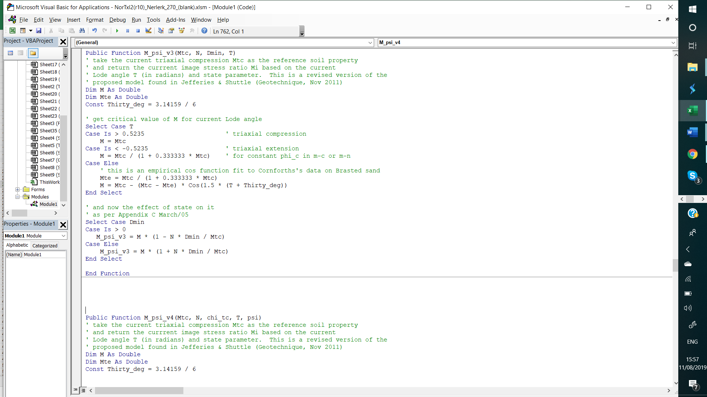
Go to function in VBA and modify

Slide 49
Re-run code after changing M_psi
What is the effect of change in idealization for M on the computed soil behaviour ?
Do you need to change H and/or G to best-fit data ?

