Slide 1
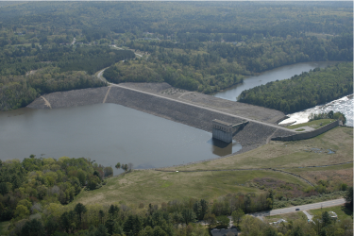
10. Drained to Undrained Transition
Dr. Dawn Shuttle, PEng
Mike Jefferies, PEng
January, 2015

Slide 2
Why dams with FS= 3 fail…

Slide 3

Drained until instant of failure

Slide 4
Soil loading as two steps
DRAINED: du/dt > du/dt
Deviator stress, p
How fast is the rate of excess pore pressure creation compared to the rate of drainage ?
Mean effective stress, p

Slide 5
Open an undrained calibration (Tests 6, 7 or 10)
Your calibration of NS to loose Nerlerk sand

Slide 6
An increment of drained loading
Add a bit of drained loading => η₀ = 0.3
Remove the over-consolidation as loading => OCR=1.0
RUN SIM

Slide 7
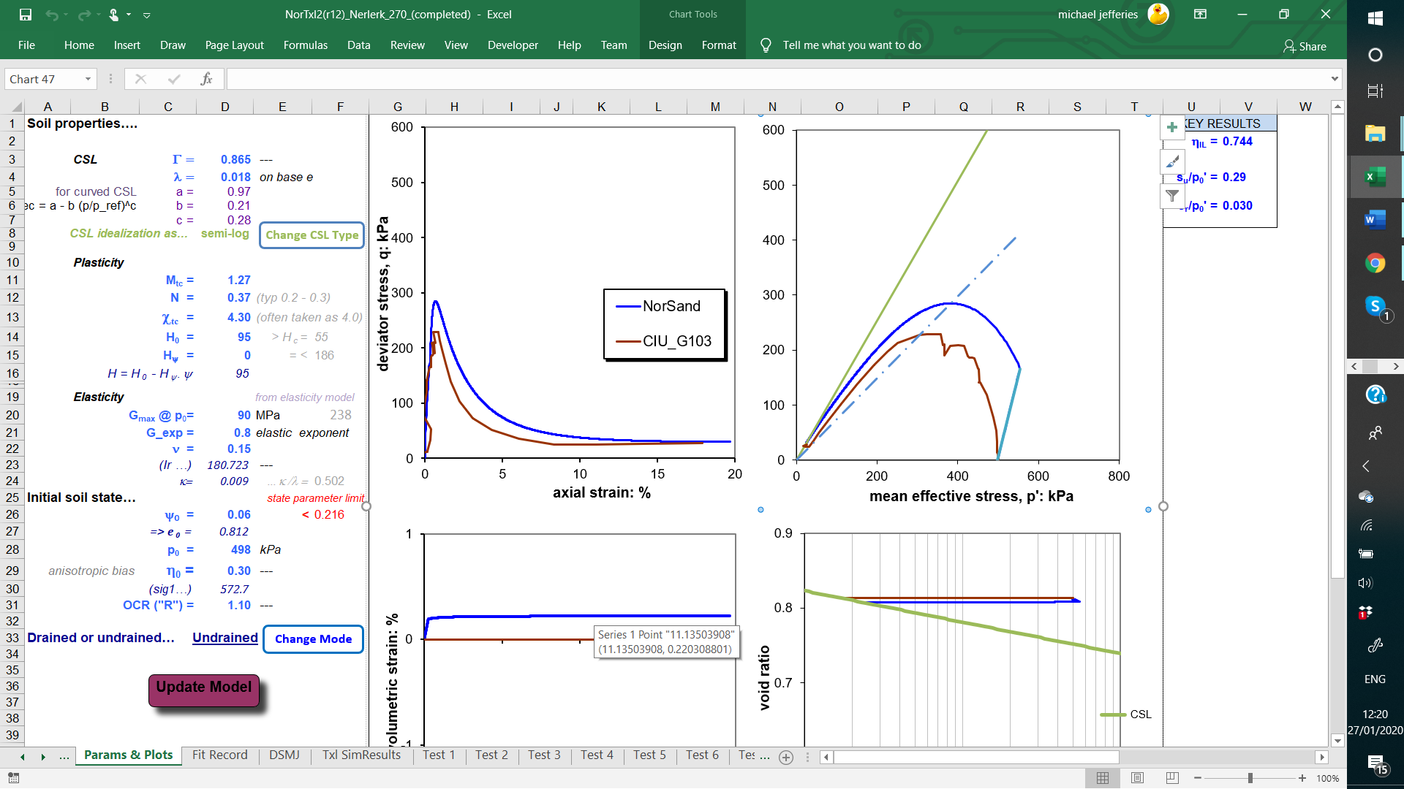
After first increment of drained loading…

Slide 8
A bit more drained loading
Add a bit more drained loading => η₀ = 0.6
RUN SIM

Slide 9
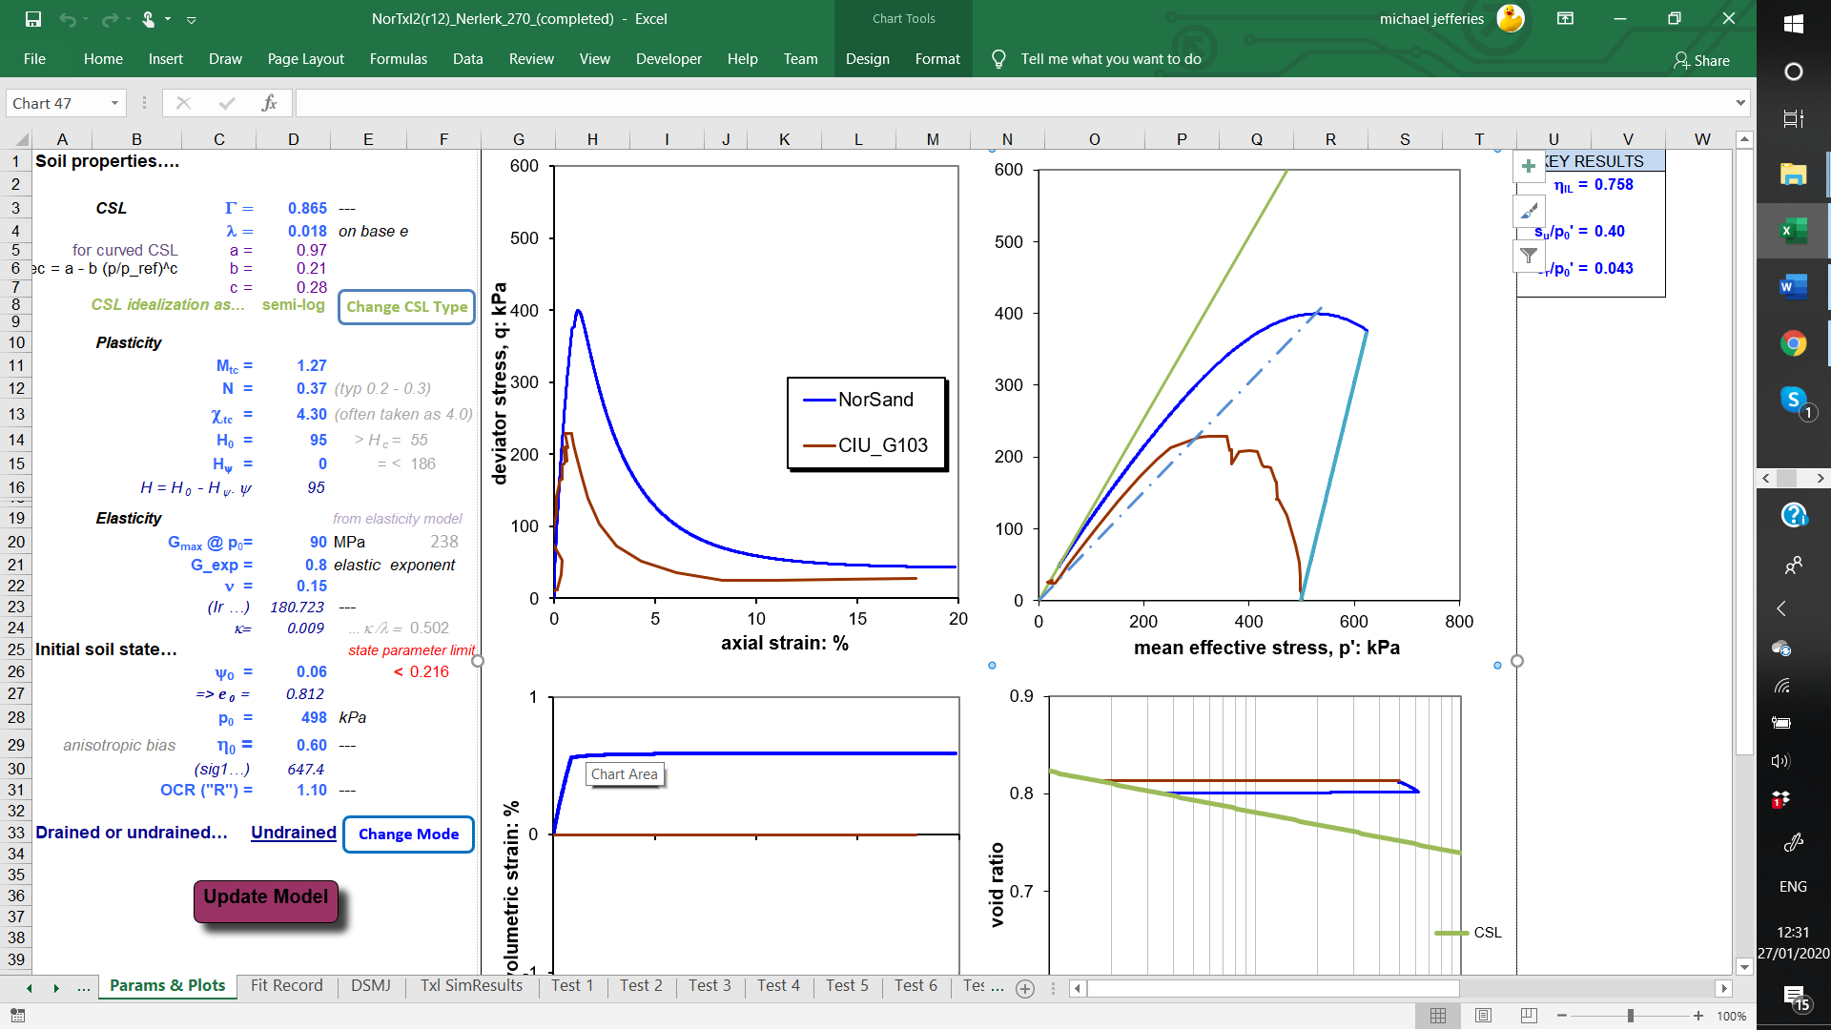
After a bit more drained loading…
Instability locus

Slide 10
And yet more drained loading…
Add a bit more drained loading => η₀ = 0.8
RUN SIM

Slide 11
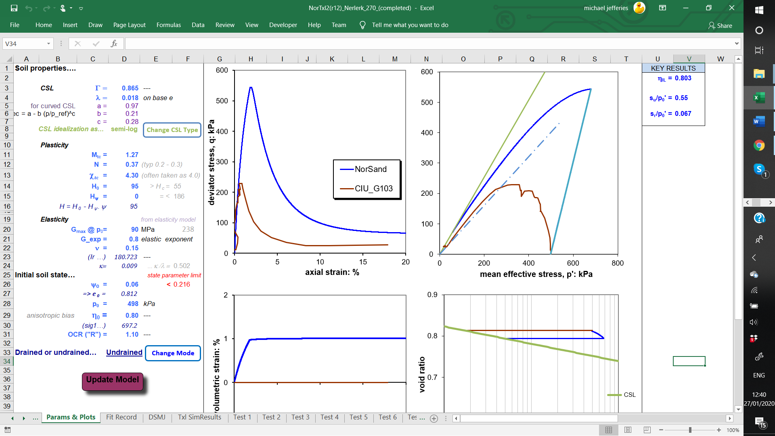
When the instability locus is exceeded…
Negative stiffness beyond instability locus
Zero, nada, rien excess pore pressure
at instability

Slide 12
Propagation of instability
Elastic shear wave: V_{s} ~ 200 m/s
Plastic shear wave: κ V_{s} / λ ~ 50 m/s

Slide 13
How is NS simulating this behaviour ?
NOTHING ADDED TO THEORY !

Slide 14
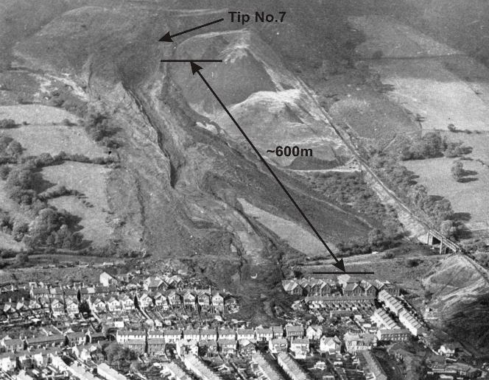
Aberfan failure (1966)

Slide 15
Instability criterion
…automatically allows for effect of σ₂

Slide 16
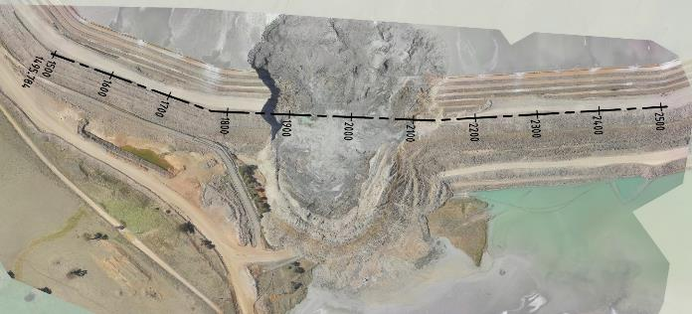
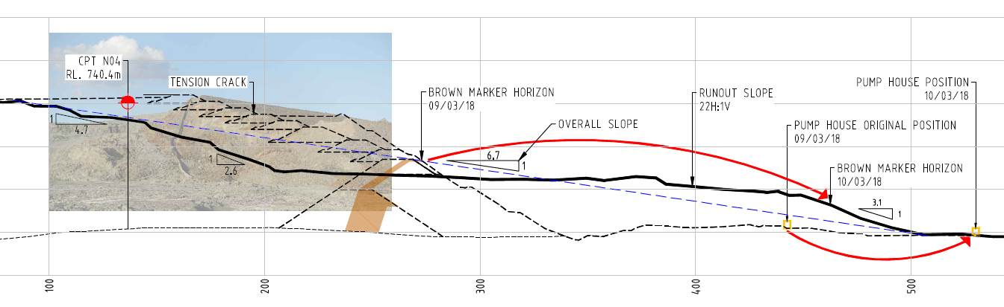
Cadia 2018

Slide 17
Evolution of ψ during construction history
CPT

Slide 18
Stress-state after berm construction
Anti-liquefaction berm

Slide 19
Instability at ‘Point 1’: DSS

Slide 20
Behaviour at instability locus

Slide 21
Drainage path matters…
DRAINED: du/dt > du/dt

Slide 22
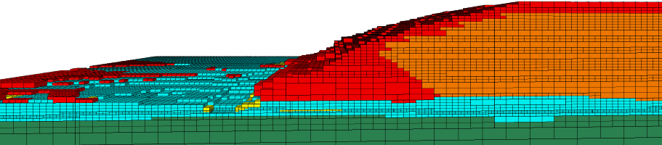
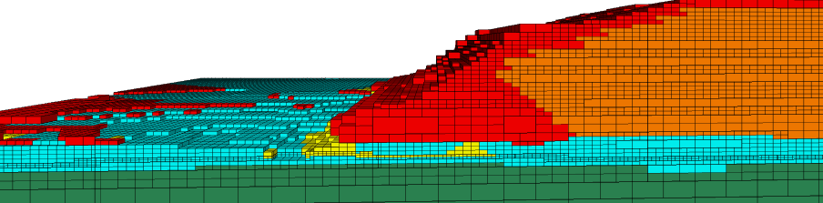
Foundation strain-weakening
Stage 10
First ‘stabilizing’ buttress

Slide 23
“Liquefaction failures” caused by foundations
Fort Peck (USA)
Nerlerk (Canada)
Los Frailes (Spain)
Mt Polley (Canada)
Cadia (Australia)
Do not just focus on liquefaction !

