Slide 1
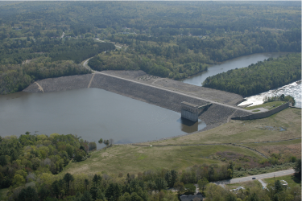
7. Cone Penetration Test - Methodology
Dr. Dawn Shuttle, PEng
Mike Jefferies, PEng
March, 2018

Slide 2
Overview of Module
What is the CPT, field procedures: getting the data
Assessing the soil types you are dealing with: stratigraphy
Soil state/strength
    Total stress method
    Effective stress method drained
    Effective stress method ‘universal’
    Effective stress method undrained

Slide 3
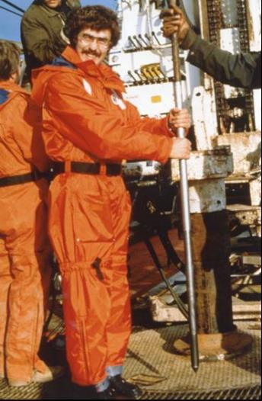
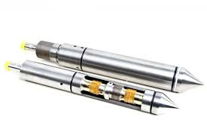
The electronic CPTu
f_{s}
u₂
q_{c}
Internal electronics with temperature compensation, A-to-D, transmission
Measure inclination, temperature

Slide 4
Repeatability
About 0.5% of full scale for q_{c}, u_{c}
(eg ± 0.1 MPa)
Friction sleeve worse depending on
    if subtraction cone
    or, independent f_{s}
    your cleaning sleeve

Slide 5
STEP 1: Select your CPT
Size: 10 cm² or 15 cm²
Type: ‘subtraction’ or ‘compression’
q_{c} = f()
f_{s} = f()
q_{c} = f()
f_{s} = f() - f()

Slide 6
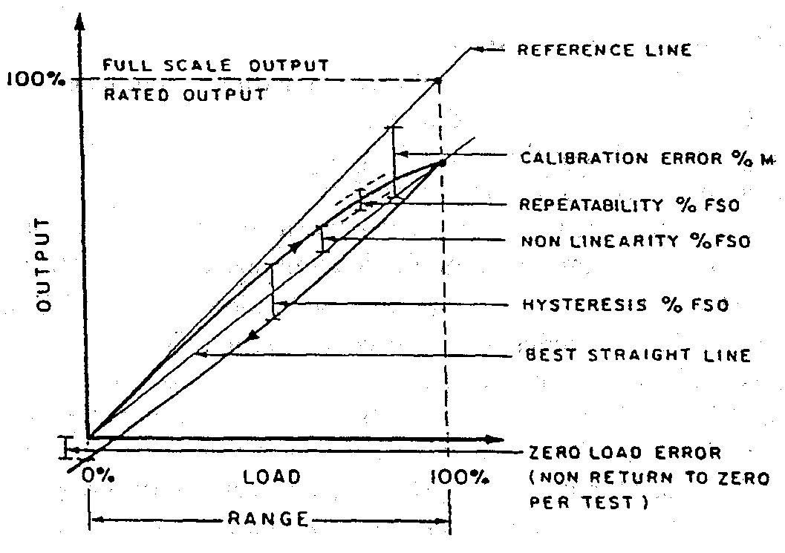
Transducer non-linearity and hysteresis
20 MPa
50 MPa
100 MPa
Tip ± 2% of FSO
Friction ± 15%
Pore pressure ± 2%
“Class 1” cones often not good enough for tailings (soft clays)

Slide 7
A practical issue for CPT: Damage
What you put in the ground you do not always get back…
    Rods can snap if inclination gets too great
    Rods can snap if hard layer encountered with soft ground above
Gravel
Pre-boring through bad ground to get started

Slide 8
Standards
ASTM D5778 (2012) ✓
International Reference Standard (in ASTM)
But no standard on data transfer format

Slide 9
Your choices
A piezocone !
Compression cone of the smallest capacity you can use
    Take a robust cone to first check the ground
Look for 0.5% accuracy cones if in soft ground
At least 14-bit AtoD
A scan rate of 1 Hz
Don’t depend on ASTM or EuroNorm standards
    They are for routine civil engineering, not soft ground

Slide 10
STEP 2: Setting up the investigation
Where do you expect the weaker ground, what do you know about the depositional environment, what do you know about the geology ?
    You can likely do better than a simple grid-pattern
    And you may be budget constrained
There is more to a CPT campaign that pushing a CPT
    Dissipation tests to define piezometric conditions
    Seismic CPT to establish Gmax profiles
    Some samples (disturbed OK) - MOSTAP

Slide 11
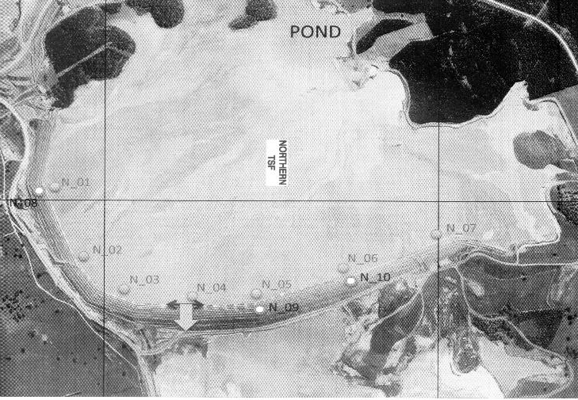
Cadia: 2017 CPT campaign for upstream raise
Earlier campaigns
2005
2013

Slide 12
Dissipation tests
If you get piezometric regime wrong, everything else will be wrong
    Measure !
If you have sand layers, then pwp in them can be used as an estimate
    Confirm in each profile with ~2 dissipation tests
Comprehensive dissipation tests in silt/clay strata one-in-four soundings
    Alternatively, devote occasional sounding to dissipation tests
Option of installing piezometers

Slide 13
Dissipation tests
1 hour

Slide 14
Underconsolidation

Slide 15
Perched water table with under-drainage

Slide 16
STEP 3: Getting ready to push the CPT
Saturation (glycerine)
Ensure clean and open filter stone
Clean friction sleeve ‘O’ rings and gaps
Zeroing, before and after push (< 1% shift)
Vertical

Slide 17
And keep an eye on where it is going…
Deviation from vertical
    sands seem worse than clays
    may break rods
Want least drillouts
    Efficiency
    Splicing records
Depth correction

Slide 18
STEP 4: Evaluate ground conditions “interpretation”
STRATIGRAPHIC
    What soil type is where
SAND
    What is their state, friction angle, liquefaction resistance…
    Drained effective-stress methods of evaluation
SILT
    What is their state, friction angle, liquefaction resistance…
    Undrained effective-stress methods of evaluation
    Undrained total-stress methods as supplement
CLAY
    What is the undrained strength s_{u}
    Undrained total-stress method
    OCR using undrained effective-stress as supplement

Slide 19
A testing report is not enough…
GET THE RAW DATA AS DIGITAL FILE
YOU ARE THE ENGINEER

Slide 20
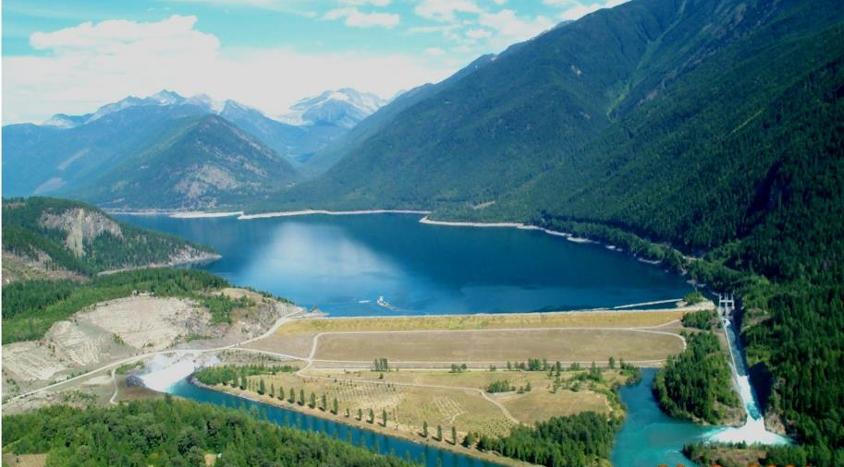
Data archive: do not rely on corporate procedures
Head dam of the Columbia River Treaty
Extensive investigation and special issue of CGJ: 1994
DSR 2010… all original data apparently lost

Slide 21
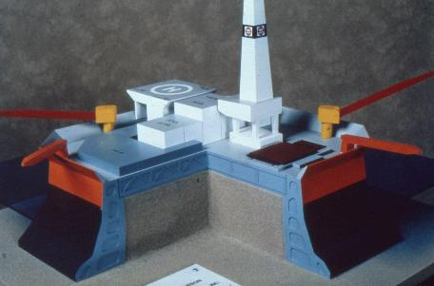
Data archive: be careful of media
600+ sensors, continuously scanned 24/7
~ 20 km of CPT soundings
~ 400+ triaxial tests
~ 200+ SBP tests
Data comprehensively archived by Gulf ~1990
Physically retrieved OK 2010. But….

Slide 22
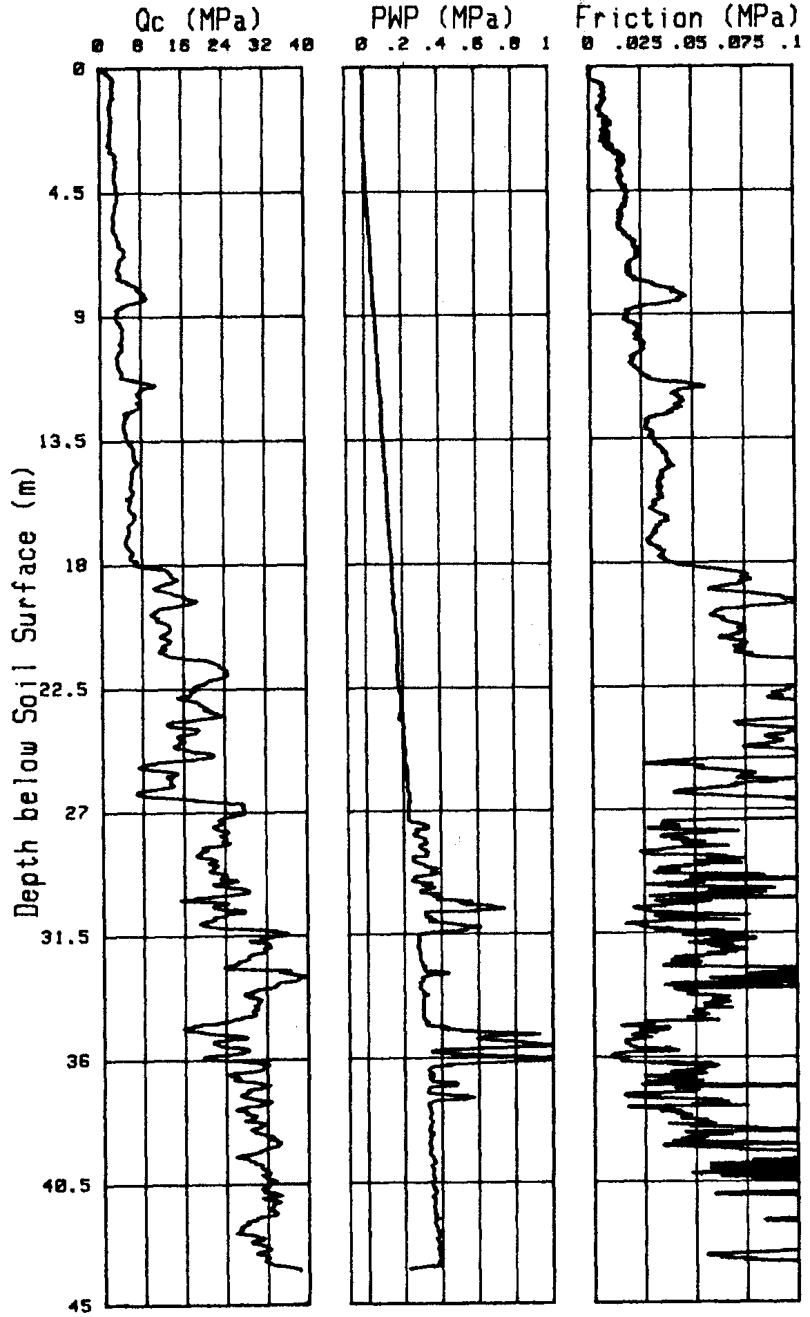
Normalizing the data: why ?
Vertical effective stress increases with depth
Soil strength & stiffness increase with stress
CPT response depends on strength and stiffness...
Must remove stress level effects to get to true soil properties/state

Slide 23
Normalizing as dimensionless numbers...
σ_{v} not σ_{m}
R_{f} = f_{s}/q_{c}
u_{c} to be measured at ‘2’ location by standard

Slide 24
Issues for dimensionless approach
What depth below ground surface did sounding start ?
Where is the water table ?
What are the soil & water unit weights ?
Adding in external knowledge to CPT data

Slide 25
Soil type identification
Basic use of CPT is to look at soil layering.
Don’t get high q_{c} in clays. Ever.
Relate q_{c} , f_{s} to soil type.
Better framework includes B_{q}

Slide 26
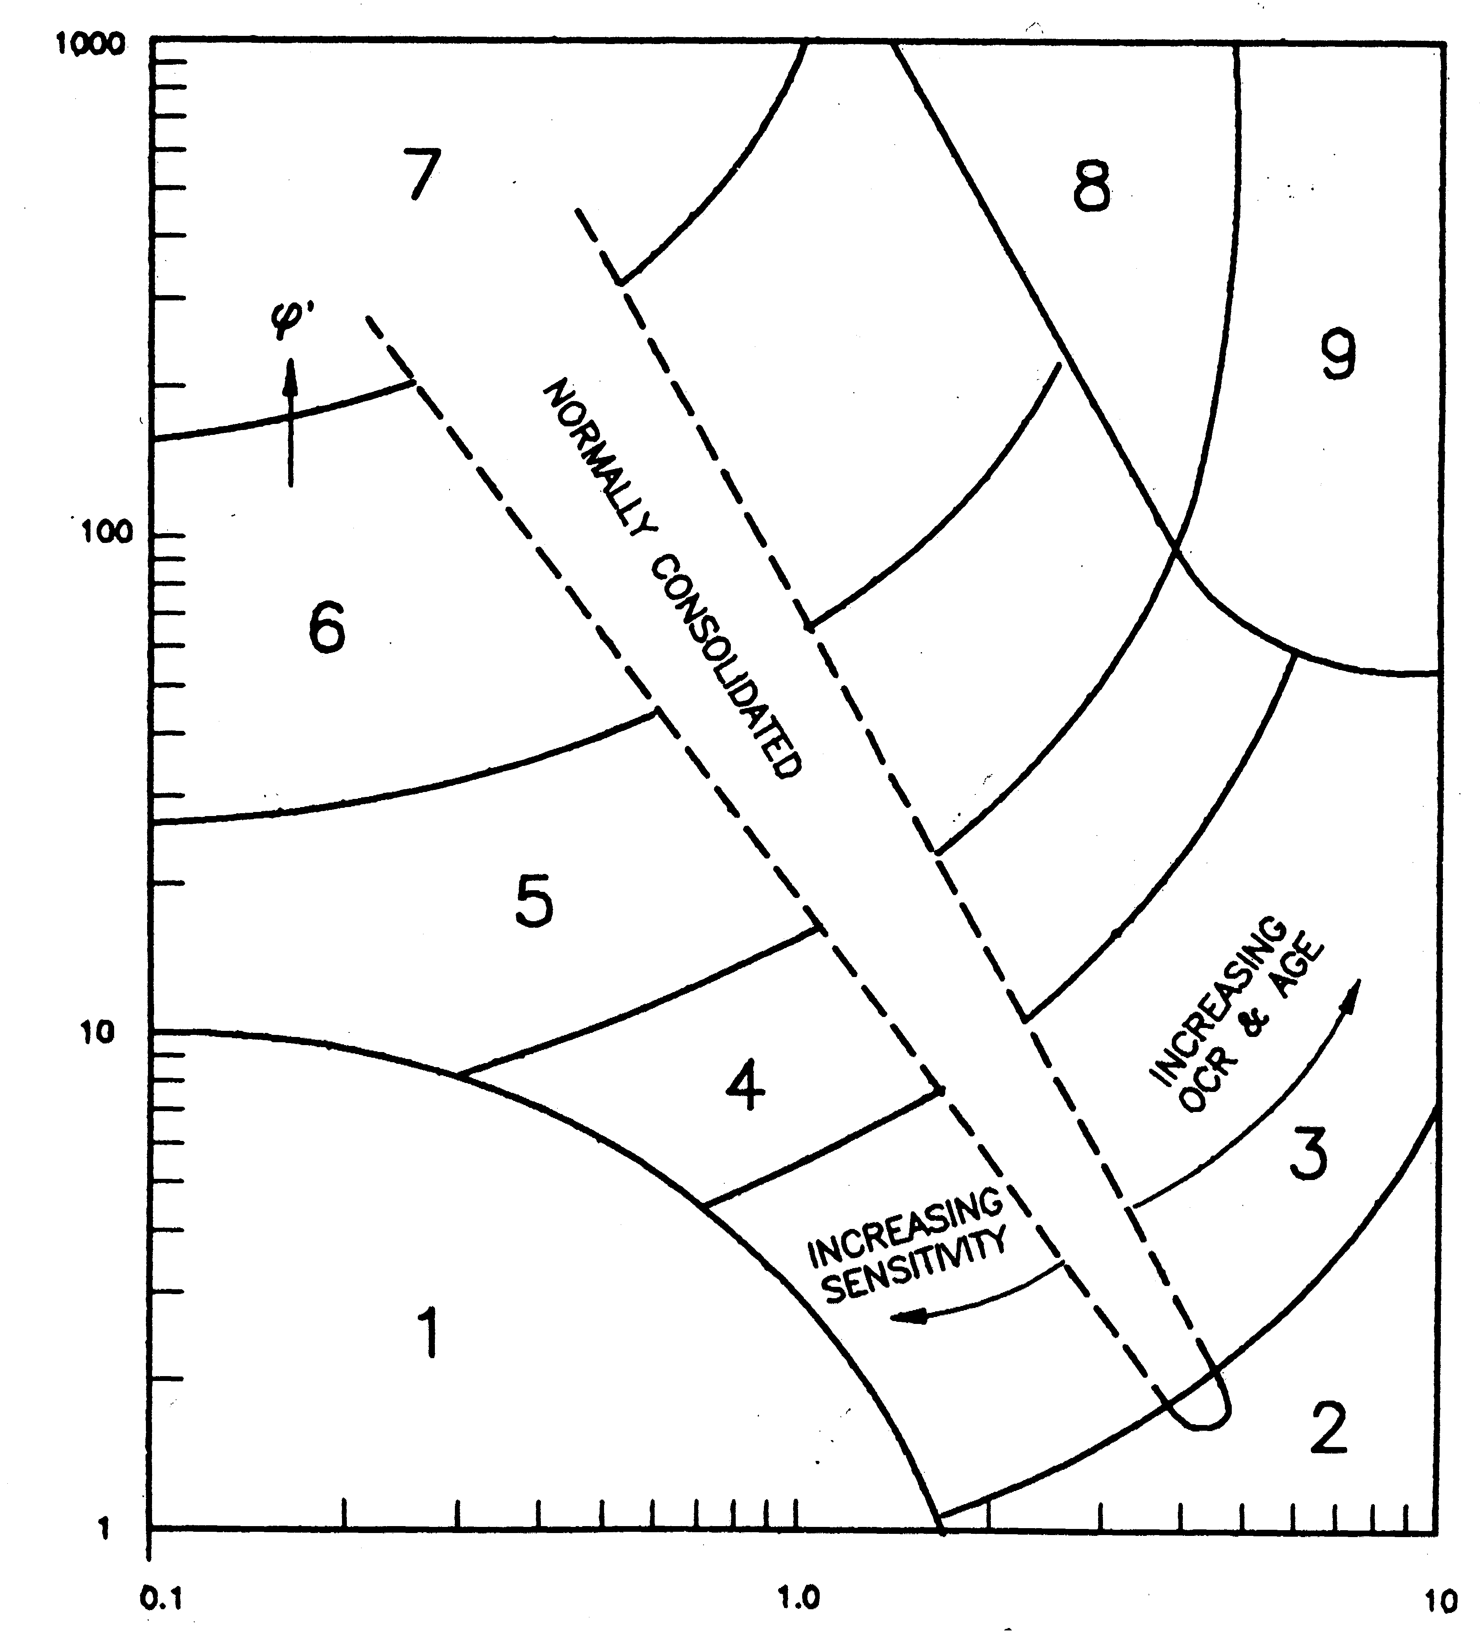
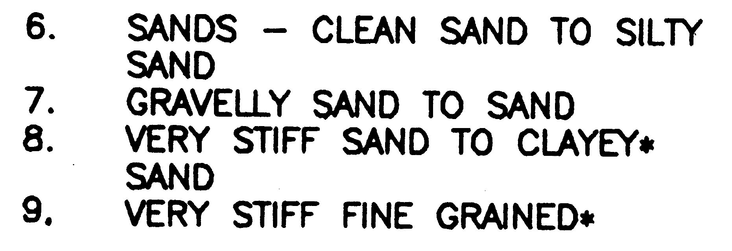
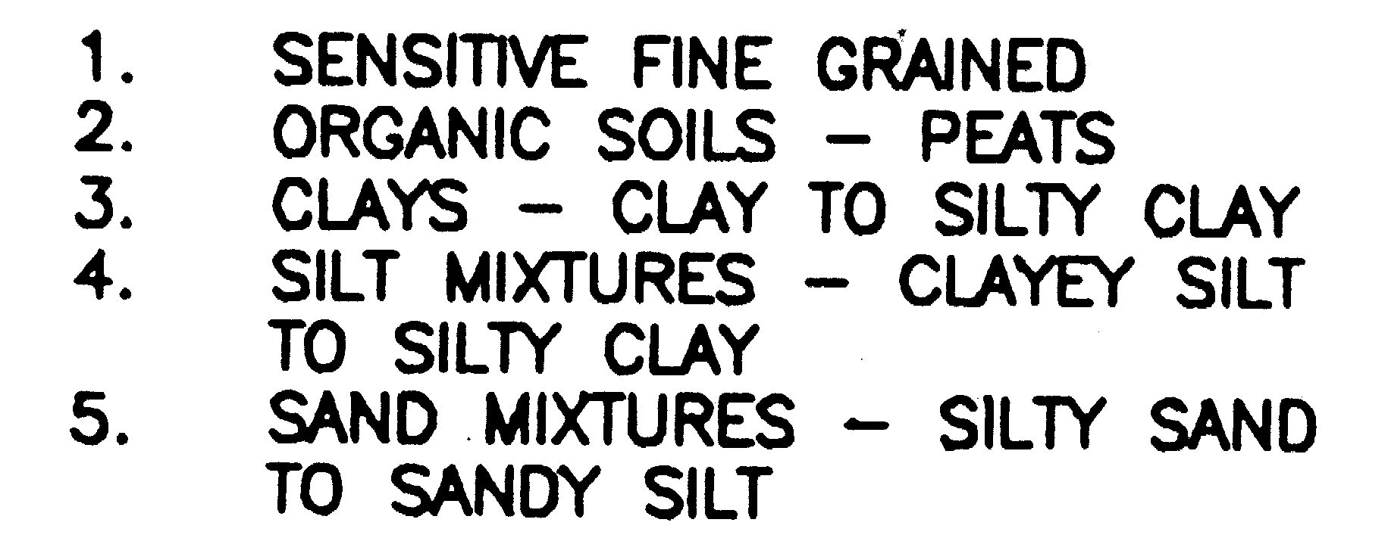
Based on case history data...
Q
F
CGJ: Robertson & Campanella (1986)

Slide 27
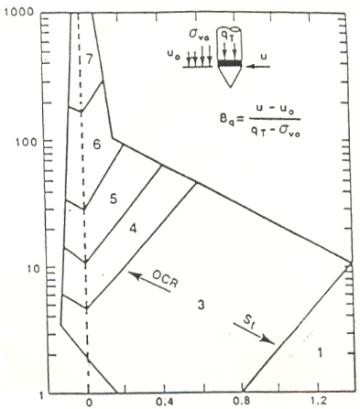
First attempt using u_{c} data...
Not as much data behind it as Q-F chart
Sometimes conflicts with Q-F
Q
B_{q}

Slide 28
Better approach: use all data at the same time
Q(1- B_{q})+1 = (q_{t}-u₂)/(σ_{v0}-u₀)
‘Trust is wonderful, but distrust is better’
    Check with your own
    case-histories

Slide 29
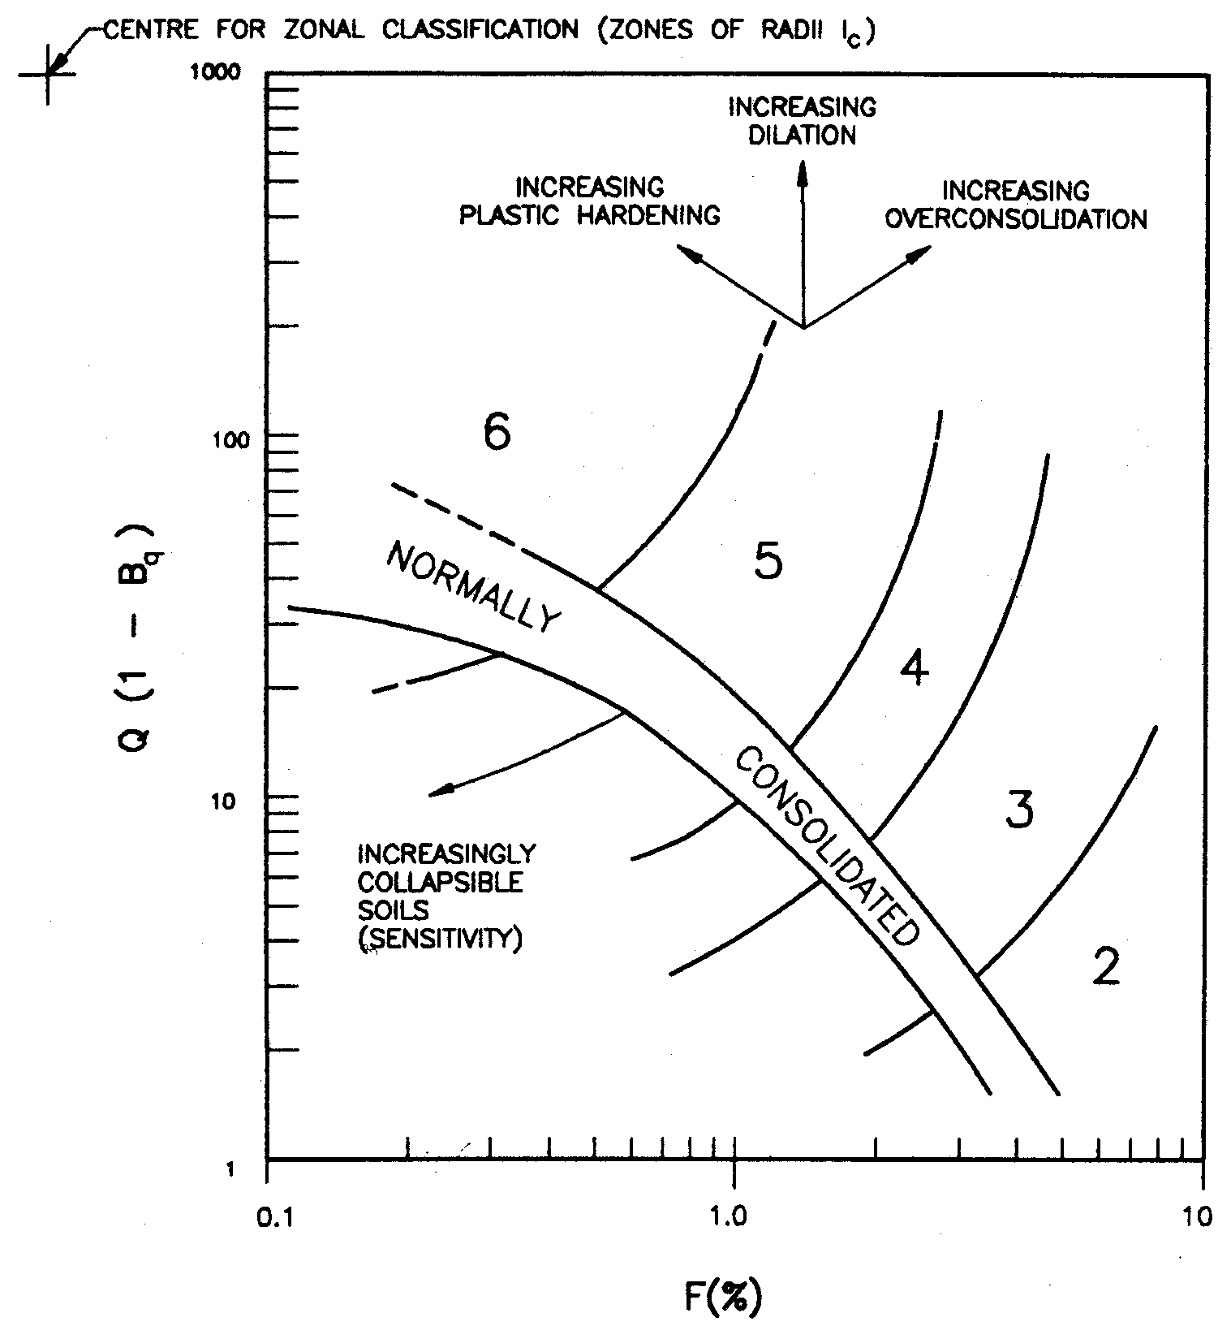
Soil classification index: I_{c}

Slide 30
Example of stratigraphic evaluation

Slide 31
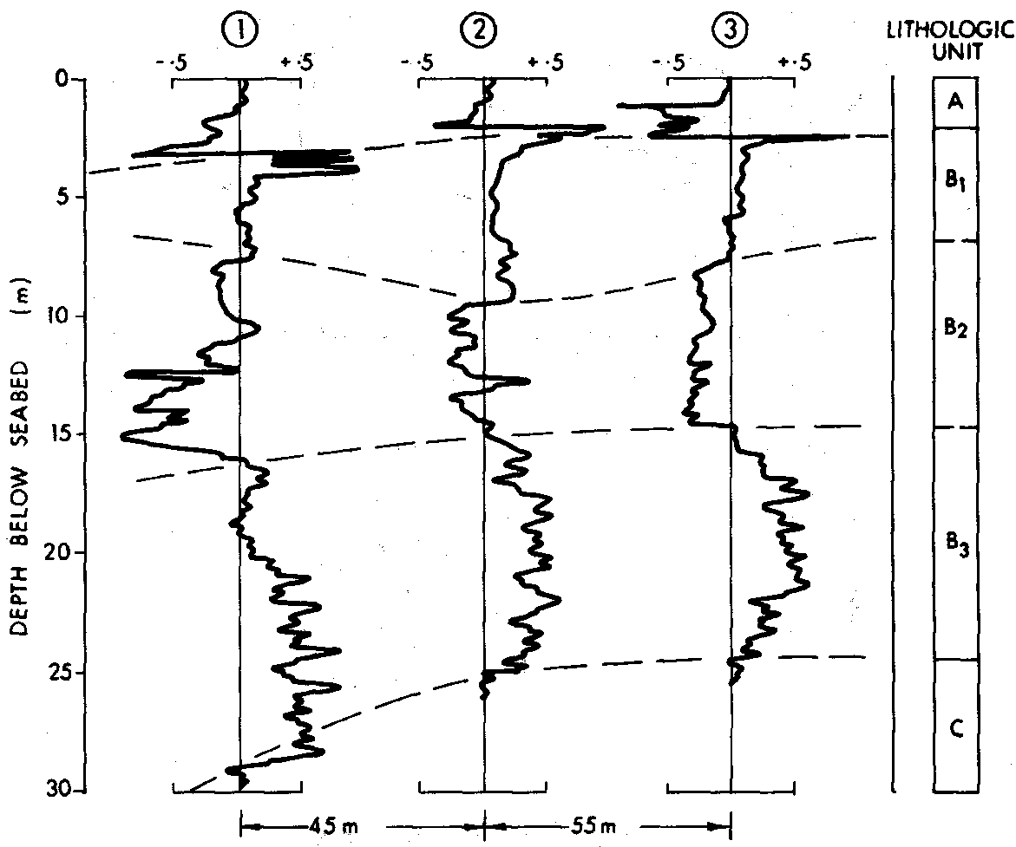
Stratigaphy... usually from B_{q} rather than I_{c}
B_{q}

Slide 32
CPT processing
Import CPT data
Define soil density (approximate) and piezometric conditions
Have a look at the data
    Is what you see consistent with your field notes and QA ?
    What stratigraphy exists ?
    Geologically reasonable ?
Quantitative evaluation of strengths etc

Slide 33
Load and open CPTplot(r25)_SandExample.xlsm
“enable macros”

Slide 34
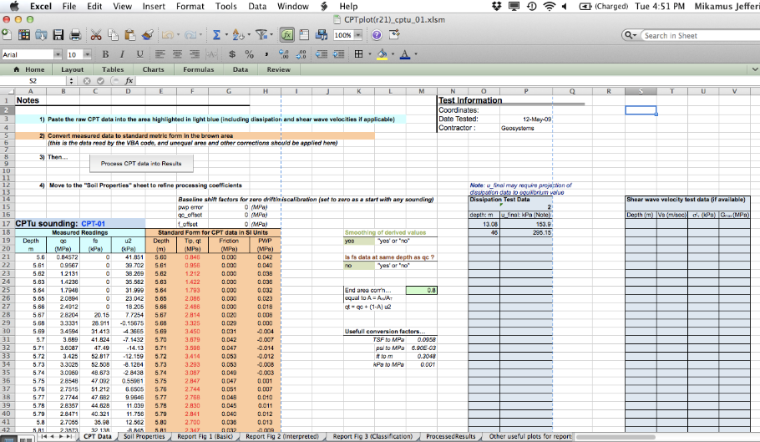
Layout of “CPTplot_*.xls”

Slide 35
Data import: “CPT data”
Dissipation u0
Shear wave v_{s}
CPT data

Slide 36
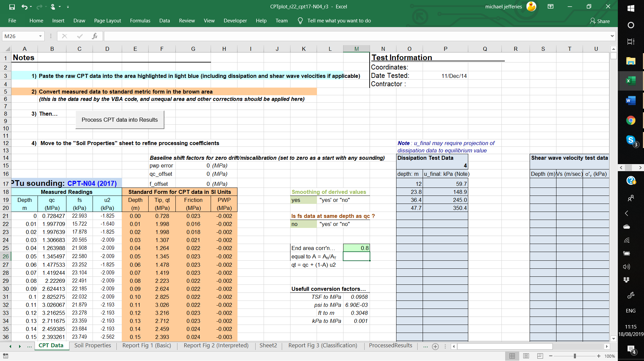
Set unequal area ratio

Slide 37
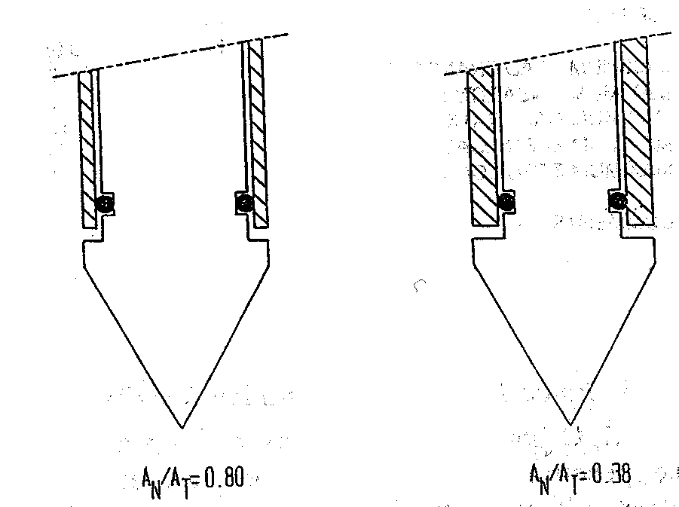
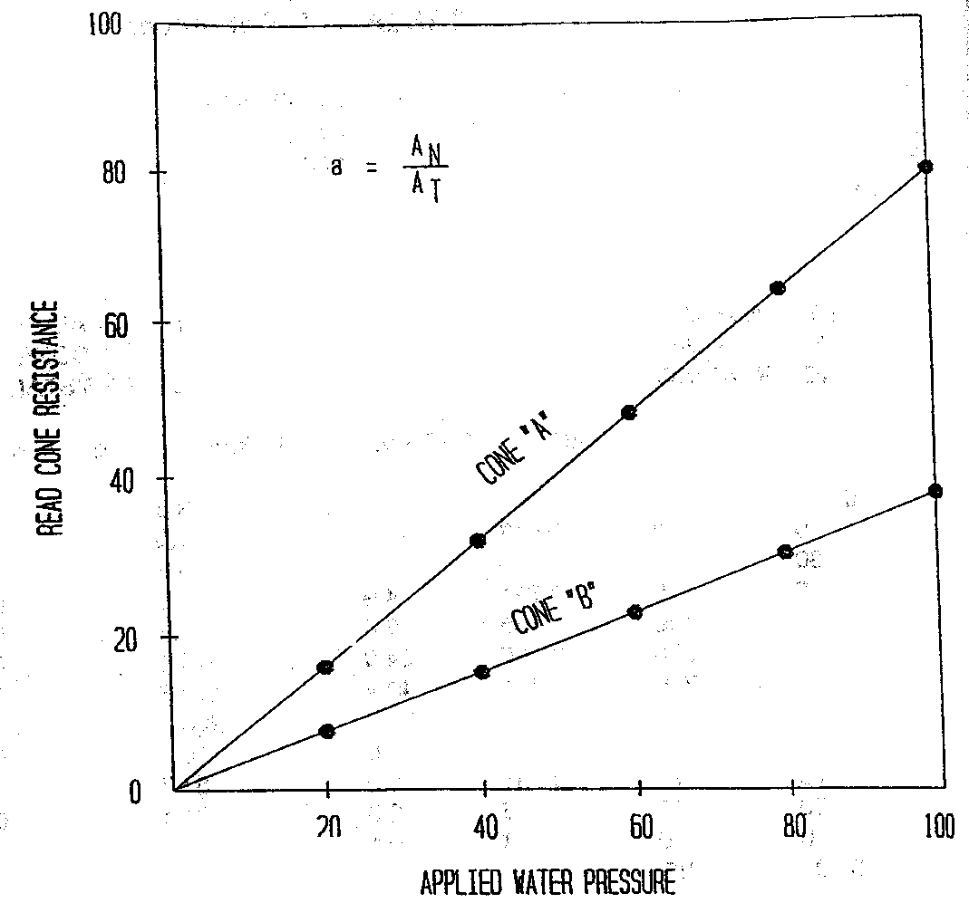
Unequal end area correction...
Measure
“a” net area ratio
q_{t} = q_{c} + u_{c} (1- a)

Slide 38
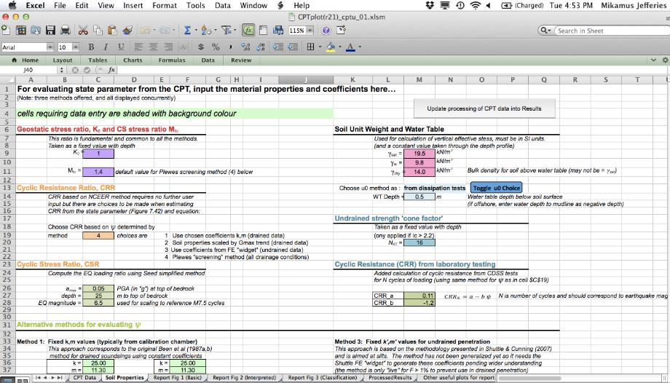
Define total stress and piezometric conditions

Slide 39
Program outputs
‘Processed Results’
    All you could ever want for plotting as processed values
    All done in VBA
Three pre-defined output sheets
  ‘Report Fig 1’
  …an echo of the data and normalized results plotted by depth
  ‘Report Fig 2’
  …the engineering parameters you are interested in
  (which depend on your choices of method/properties)
  ‘Report Fig 3’
  …the soil behaviour type plot (which can be windowed)

Slide 40
Report Fig 1

Slide 41
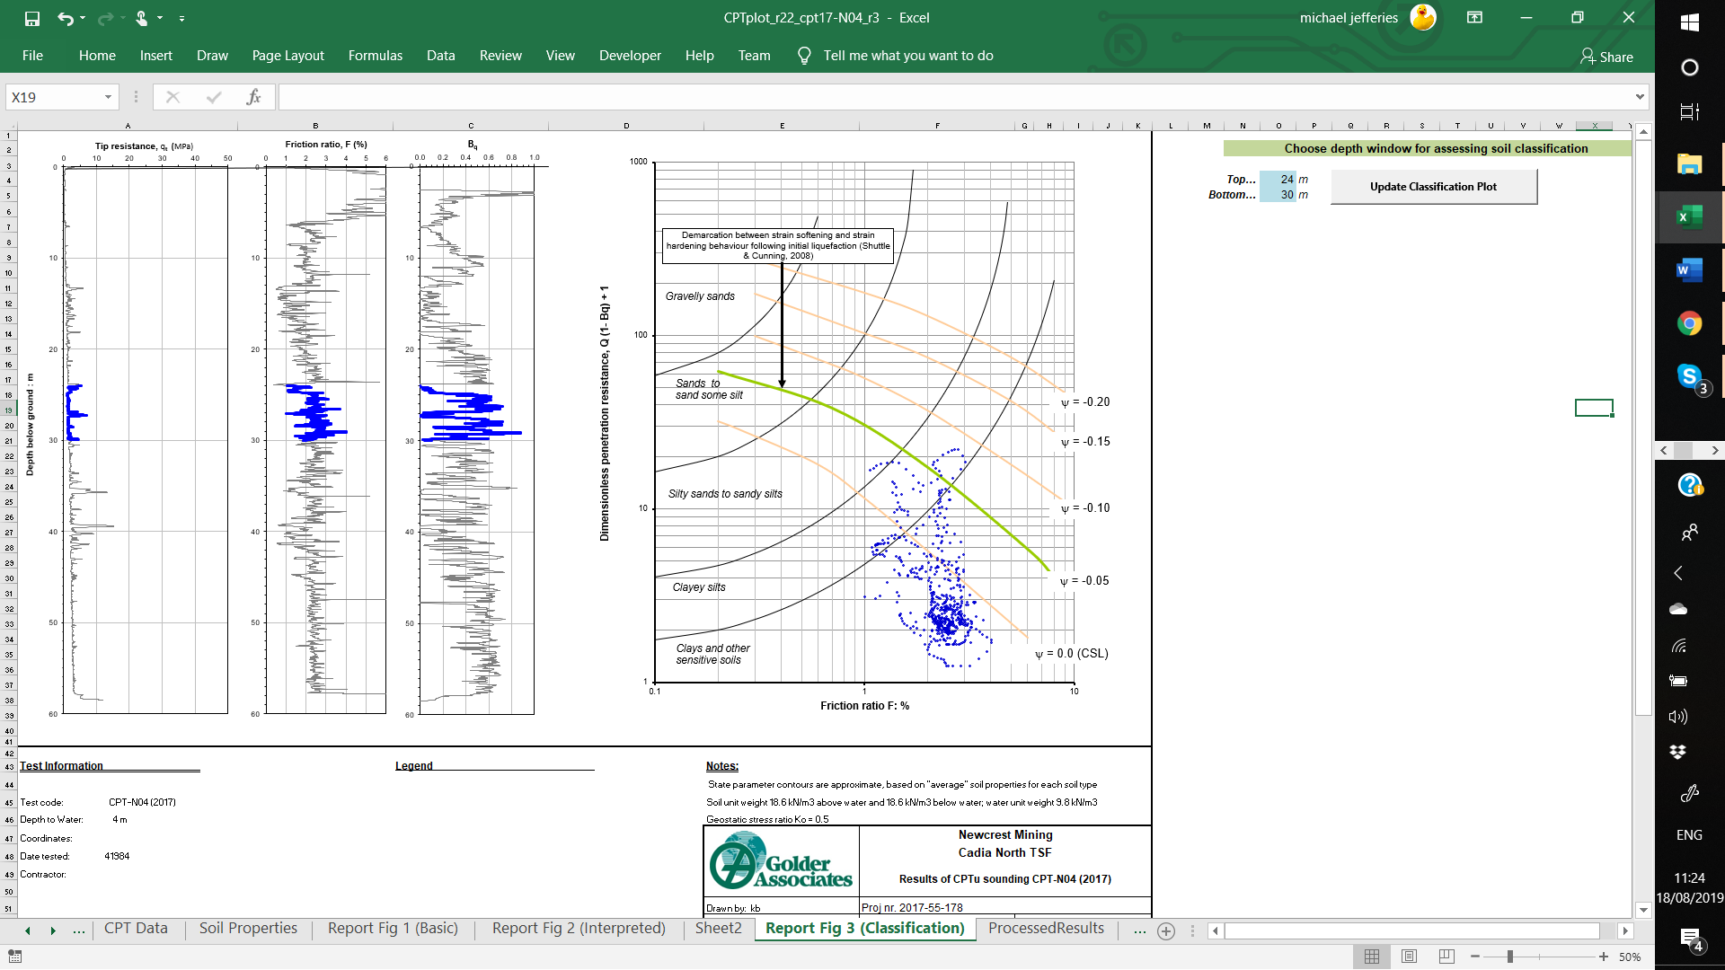
Report Fig 3

Slide 42
“Interpretation” of CPT data
Need to convert what was measured into what we want
    Do not directly measure σ−ε
    CPT data must be “interpreted”: Inverse Boundary Value Problem
Detailed fundamental evaluation of CPT beyond current soil mechanics
Methods:
    TOTAL STRESS
        calibrate to a ‘reference’ test (e.g. to s_{u} from vane)
    EFFECTIVE STRESS
        calibrate in laboratory using a chamber
        cavity expansion using true soil properties
        ‘universal’ method
    DIRECT TO PERFORMANCE
        relate data to through back-analysis of failures (case-histories)

Slide 43
Curse of correlations...
Correlations without theoretical basis usually mislead
Can’t get four independent properties from one measurement
Much in situ literature based on unthinking development of correlations

Slide 44
TOTAL STRESS: CPT evaluation in CLAY
Theory: cavity expansion in Tresca material (1945)
N_{k} was weak theoretical dependence on G/s_{u}
Wider range of N_{k} encountered in practice

Slide 45
Where does N_{k} come from ?
By calibration to a ‘reference’ test
    Triaxial compression (various protocols)
    Vane shear (assumed geometry, possible rate effect corrections)
    Self-bored pressuremeter
CPT is being used to interpolate between the ‘reference’ strengths
BUT there is a pattern with similar values for similar geological conditions

Slide 46
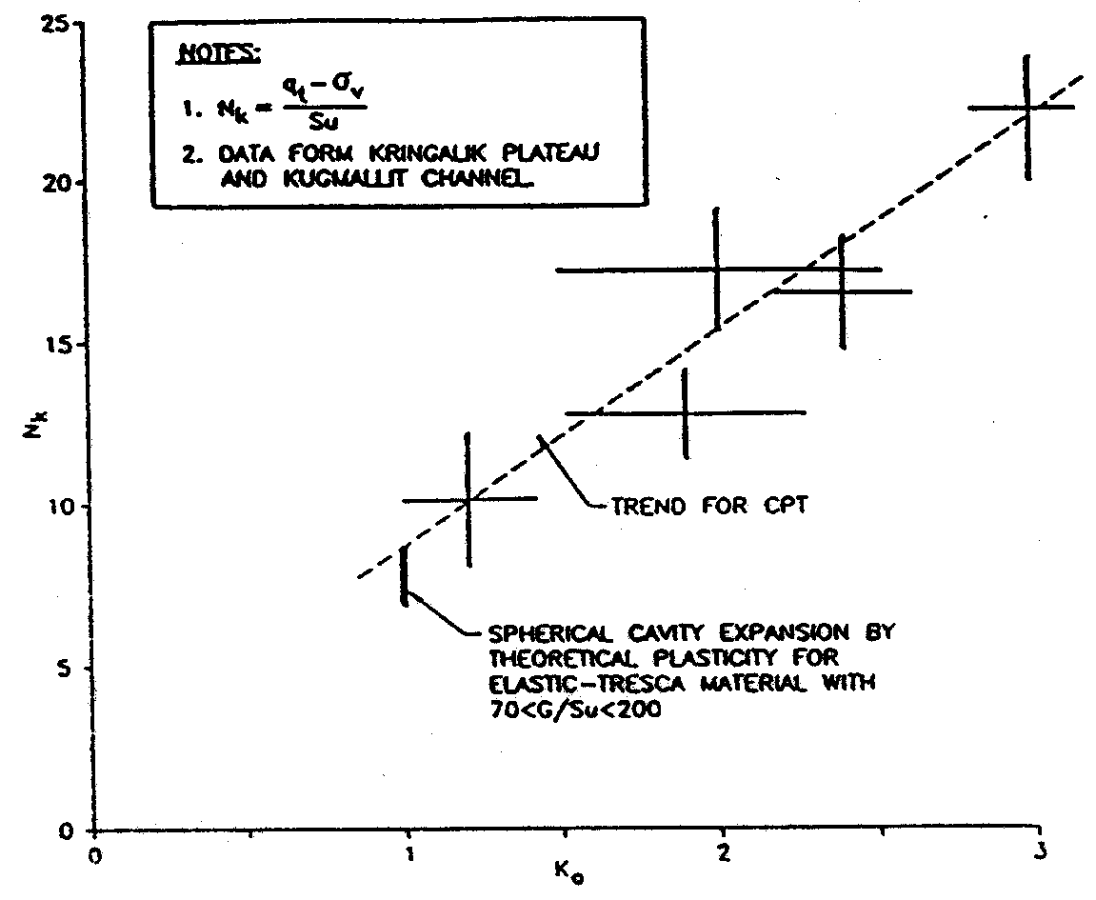
N_{k} = 16
N_{k} = 11
Soft clays
Very stiff clays

Slide 47
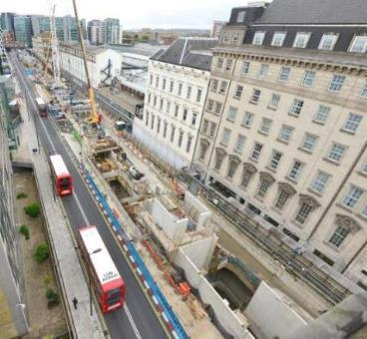
Getting s_{u} from SBP: Paddington

Slide 48
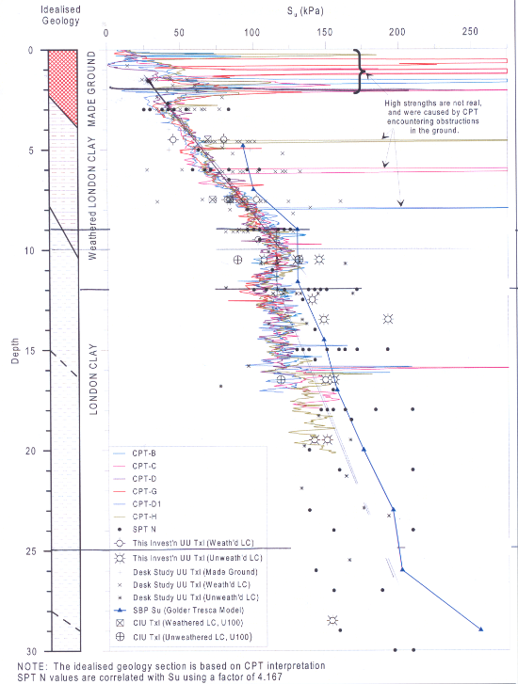

Slide 49
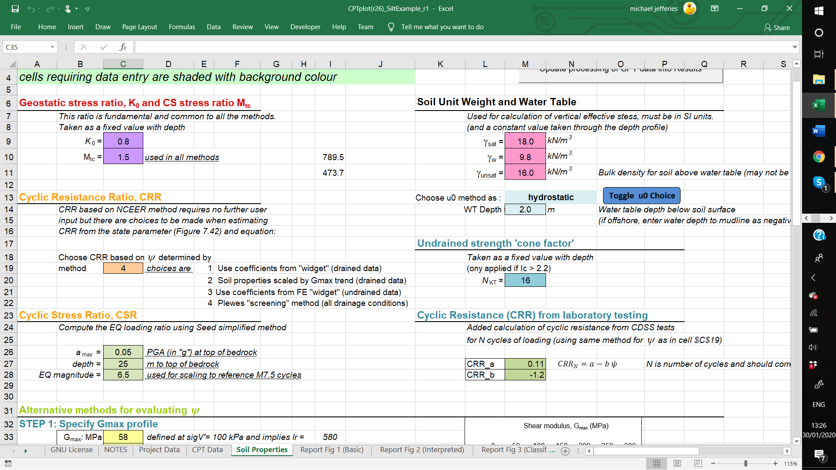
Input of N_{kt} factor
If an equation is outside its limit of validity at a particular data point, then ‘999’ is output to the Processed Results
Undrained if:
|B_{q}|>0.1 or F>1%
N_{kt} now computed by
CPTwidget if undrained

Slide 50
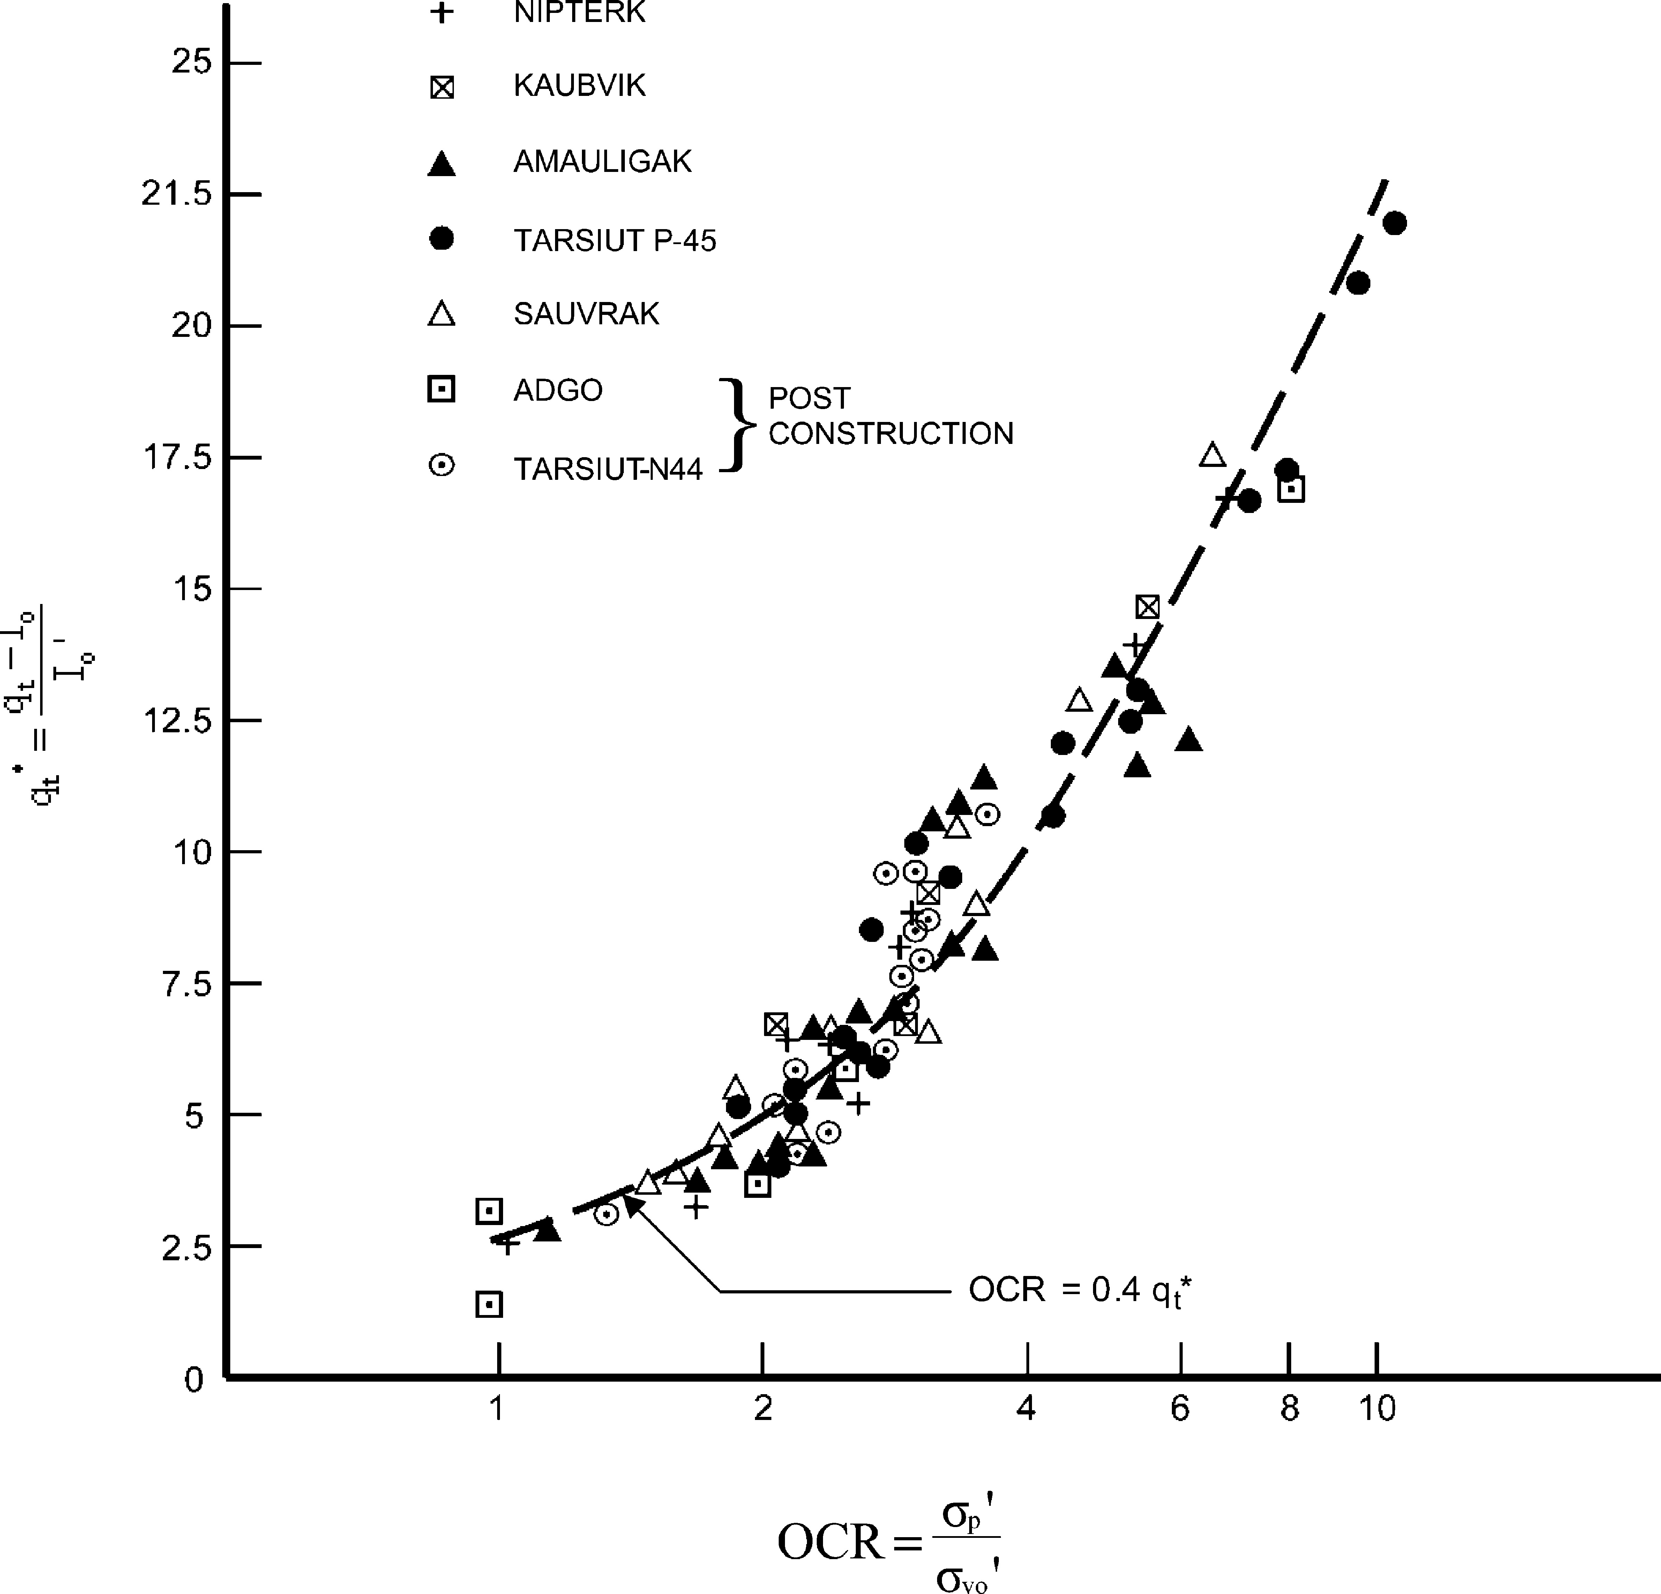
OCR from CPT
Q
Kulhawy & Mayne (1990)
Mesri (2001)
Demers & Leroueil (2002)

Slide 51
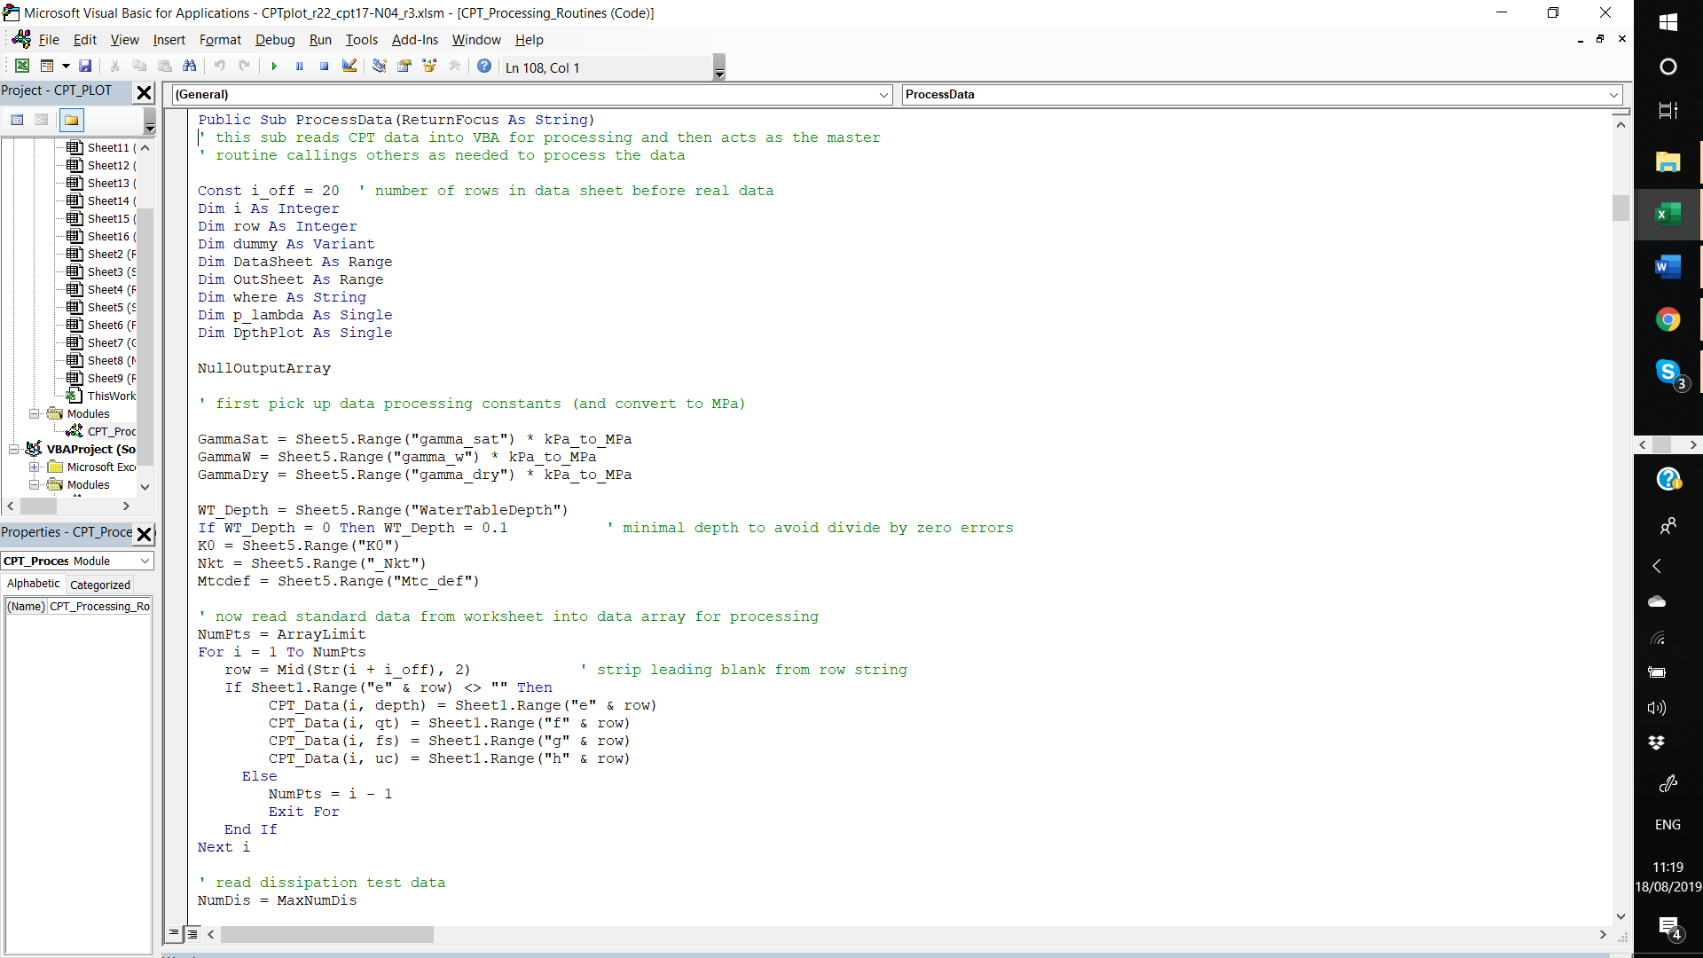
Nearly everything is in VBA

Slide 52
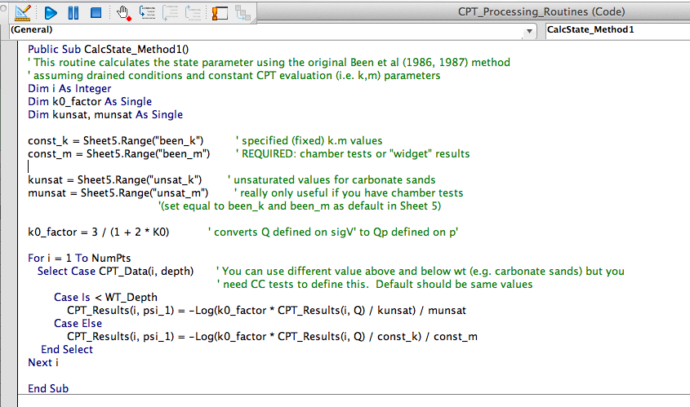
Open Code…

Slide 53
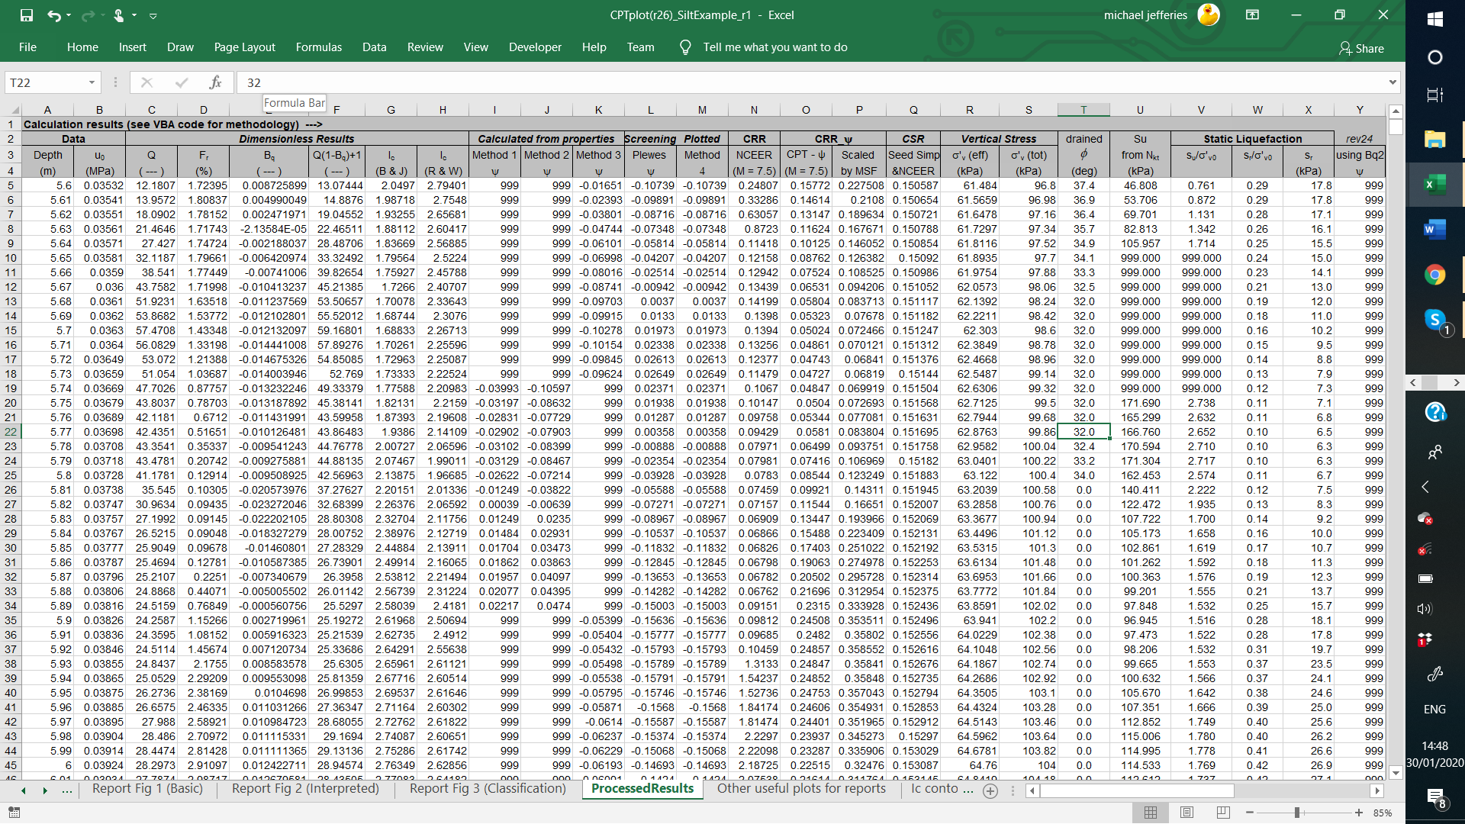
Output from VBA routines

