Slide 1
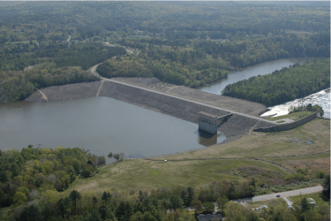
8d. Determining ψ in ANY SOIL with CPT
‘Plewes’ Method
Mike Jefferies, PEng
Dr. Dawn Shuttle, PEng
January, 2015

Slide 2
Ground soil-type varies naturally…

Slide 3
Principle of ‘universal’ method
Point to point variation in soil properties must be sensed by the CPT itself
Could do boreholes, but not routinely
Want a ‘self-contained’ method
Only presently measure q_{t}, f_{s}, u₂
Must work from this data
Start with ‘Soil Behaviour Type’

Slide 4
Principle of ‘universal’ method
M = 1.27
λ₁₀=0.05
M = 0.8
λ₁₀=0.30
f(F not I_{sbt} )

Slide 5
Getting to ψ : Method 4 (Plewes)
Reid (2015)
Assume “average” soil properties N, χ, H_{ψ}, I_{r}
Slope of CSL, λ₁₀ H = 4/λ
λ₁₀ = F(%) /10

Slide 6
Using Plewes Method
Be careful with M for tailings !

Slide 7
Plewes method output

Slide 8
Output from Method 1

Slide 9
Commentary
“screening” method
Use to identify zones of potential concern
Then evaluate those zones using soil properties
Widely mis-used !
Works amazingly well some of the time
BUT no diagnostic predictors (as yet) for where is does not
A refined/updated version needed ASAP
Plewes is based on CPT understanding as of ~1986
A great deal of data and understanding since then

